Slide 1
Going to School at Woodburn Primary School

Slide 2
I will be going to school at Woodburn Primary School.

Slide 3
My Head Teacher is Mrs Findlay. She is responsible for all the children and staff at Woodburn.

Slide 4
My teacher is _____. She will be there to help me.

Slide 5
I will walk in and put my backpack and coat away.

Slide 6
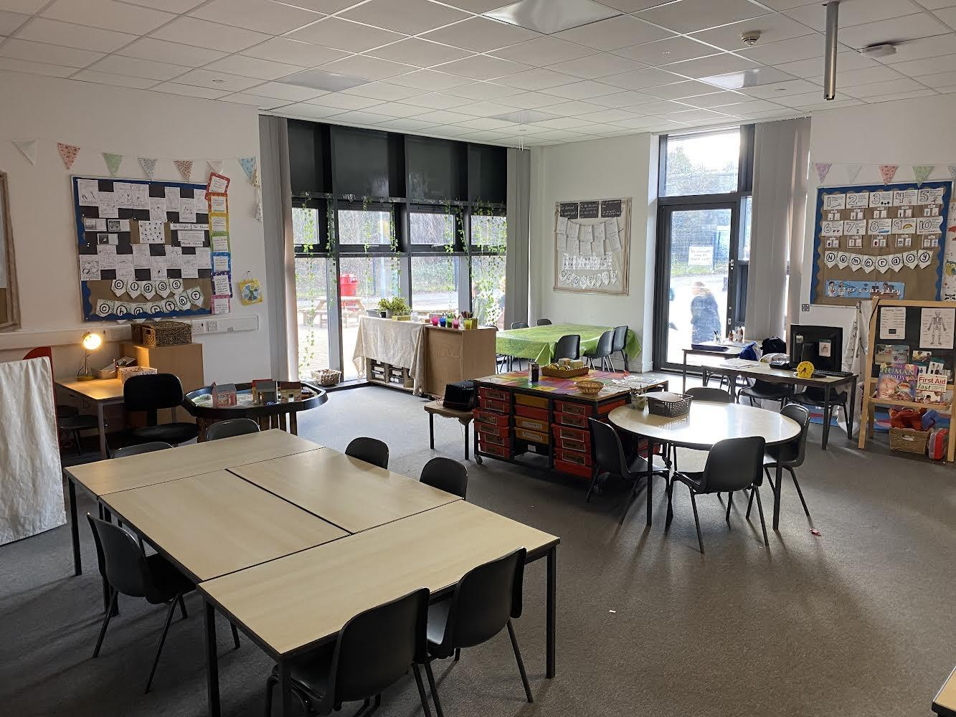
I will start my day choosing where to play with my friends in my classroom.

Slide 7
This is where we will sit when we are asked to come and sit together.

Slide 8
If I need to go to the toilet, this is where I go. I will tell an adult before going.

Slide 9
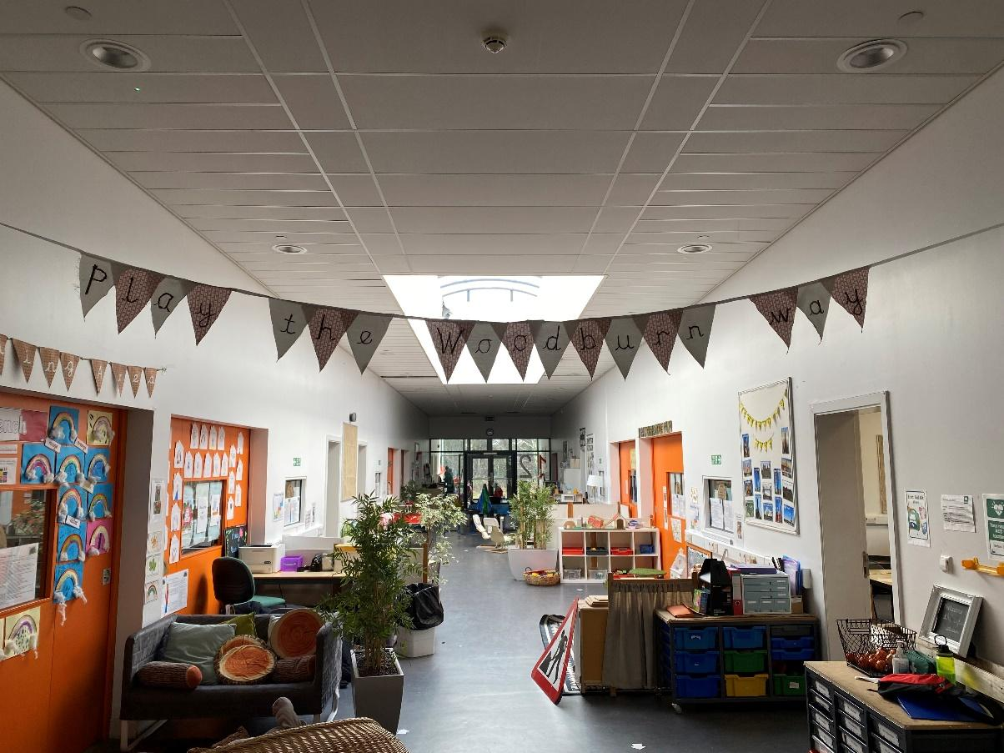
I will play inside and outside when I am learning.

Slide 10
I will eat my snack in the playground at break time.

Slide 11
I will eat my lunch in the dinner hall.

