Slide 1
Winter poems
LI: to write a short rhyming poem about Winter.

Slide 3
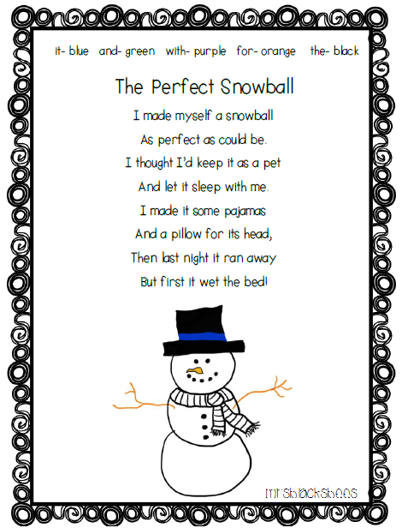

Slide 5
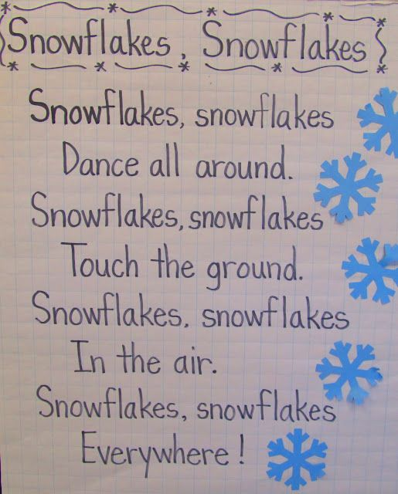

Slide 6
Use this space to create your own winter poem.

