Slide 1
Illustrations by Julian Beresford and © The Reading Agency 2022
Notes:
Please customise, add or remove slides and information to reflect how the Summer Reading Challenge is run locally.

Slide 2
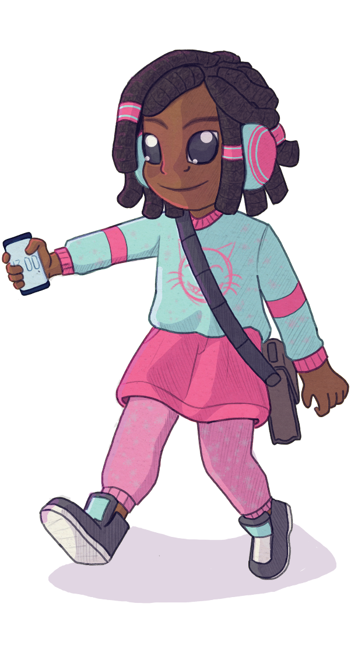
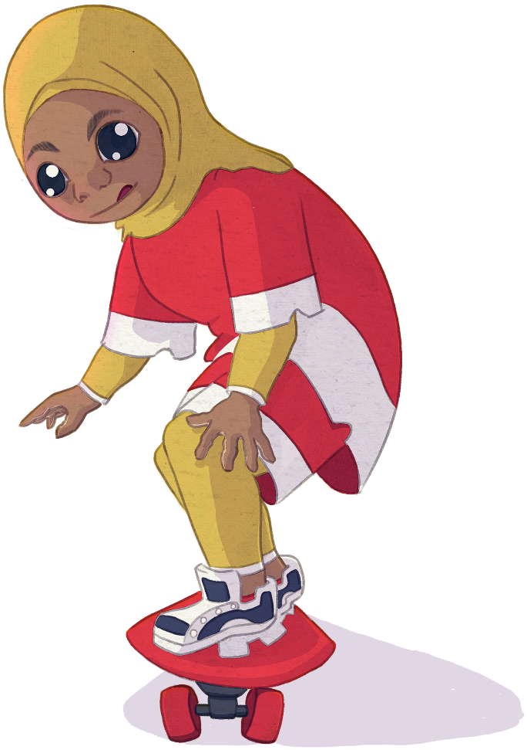
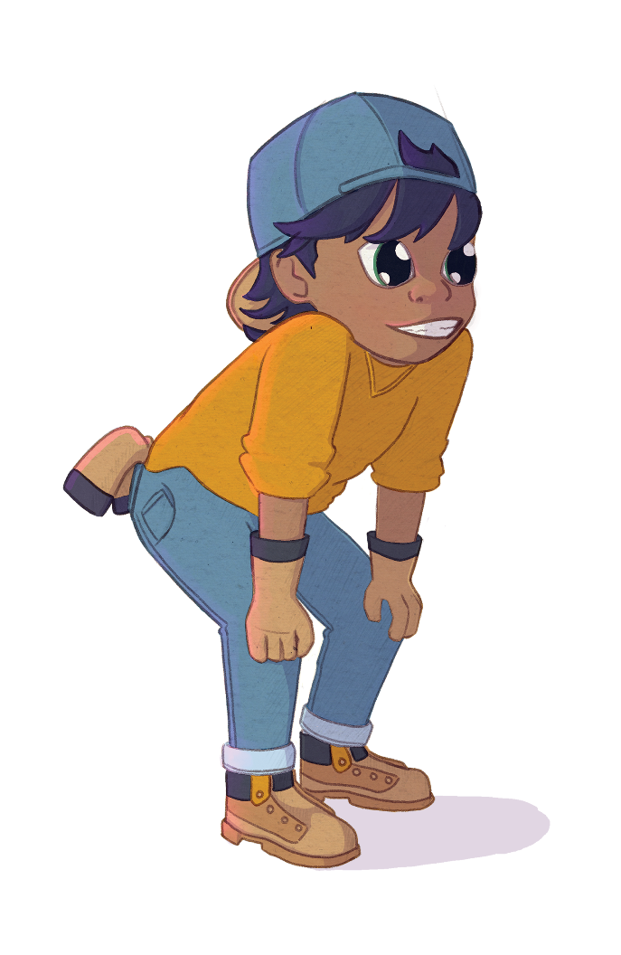
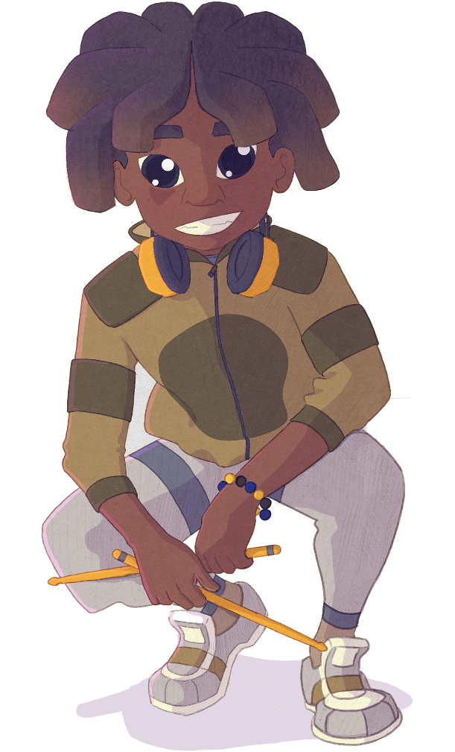
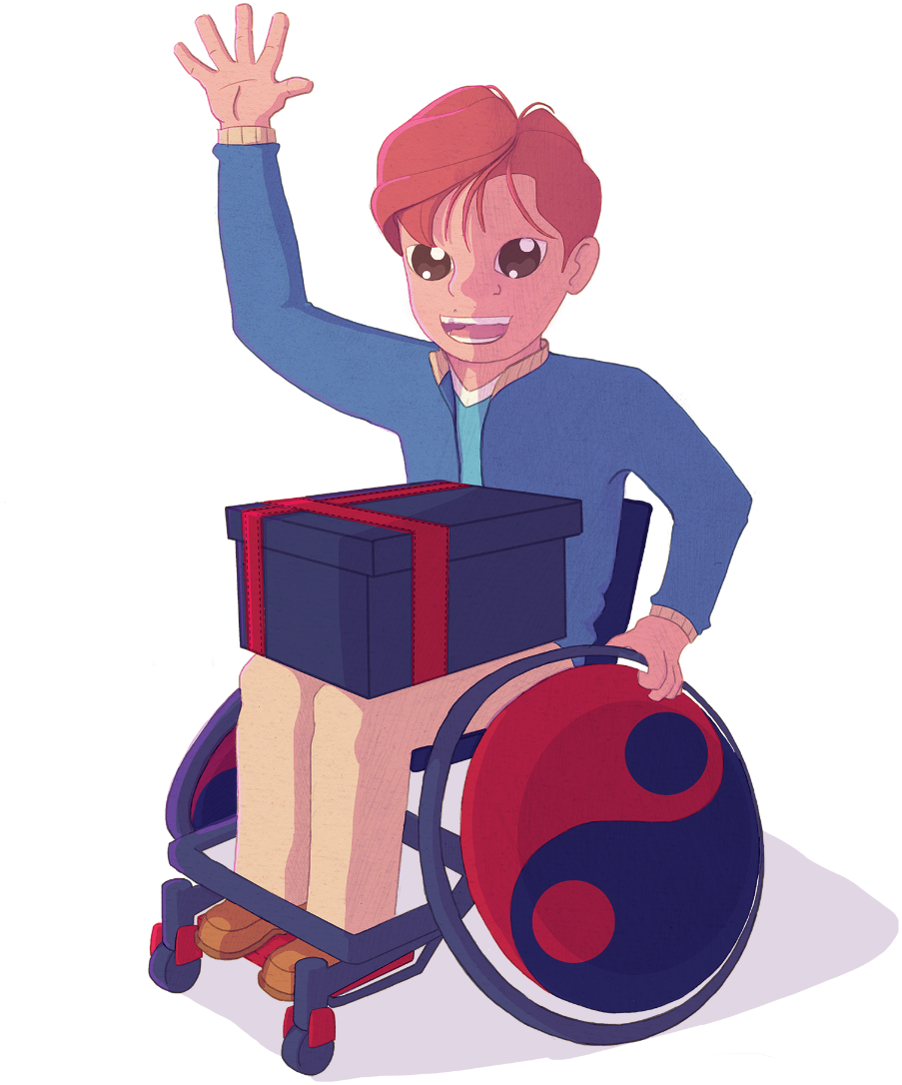
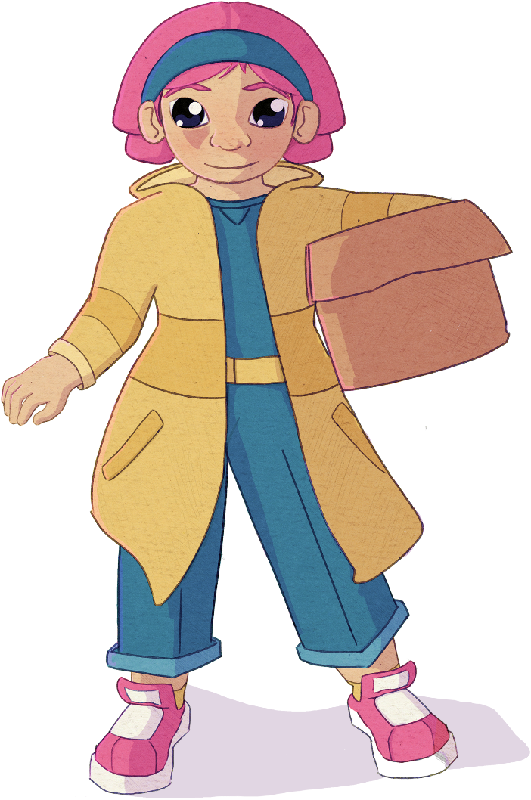
Illustrations by Julian Beresford and © The Reading Agency 2022
Notes:
Meet the Gadgeteers! Aisha, Ajay, James, Eddie, Leo, and Maggie.
The Gadgeteers love creating new inventions and working together to solve problems. They spend their days using their curiosity, creativity and innovation to come up with lots of awesome inventions. They are planning an epic summer party at their community centre.

Slide 3
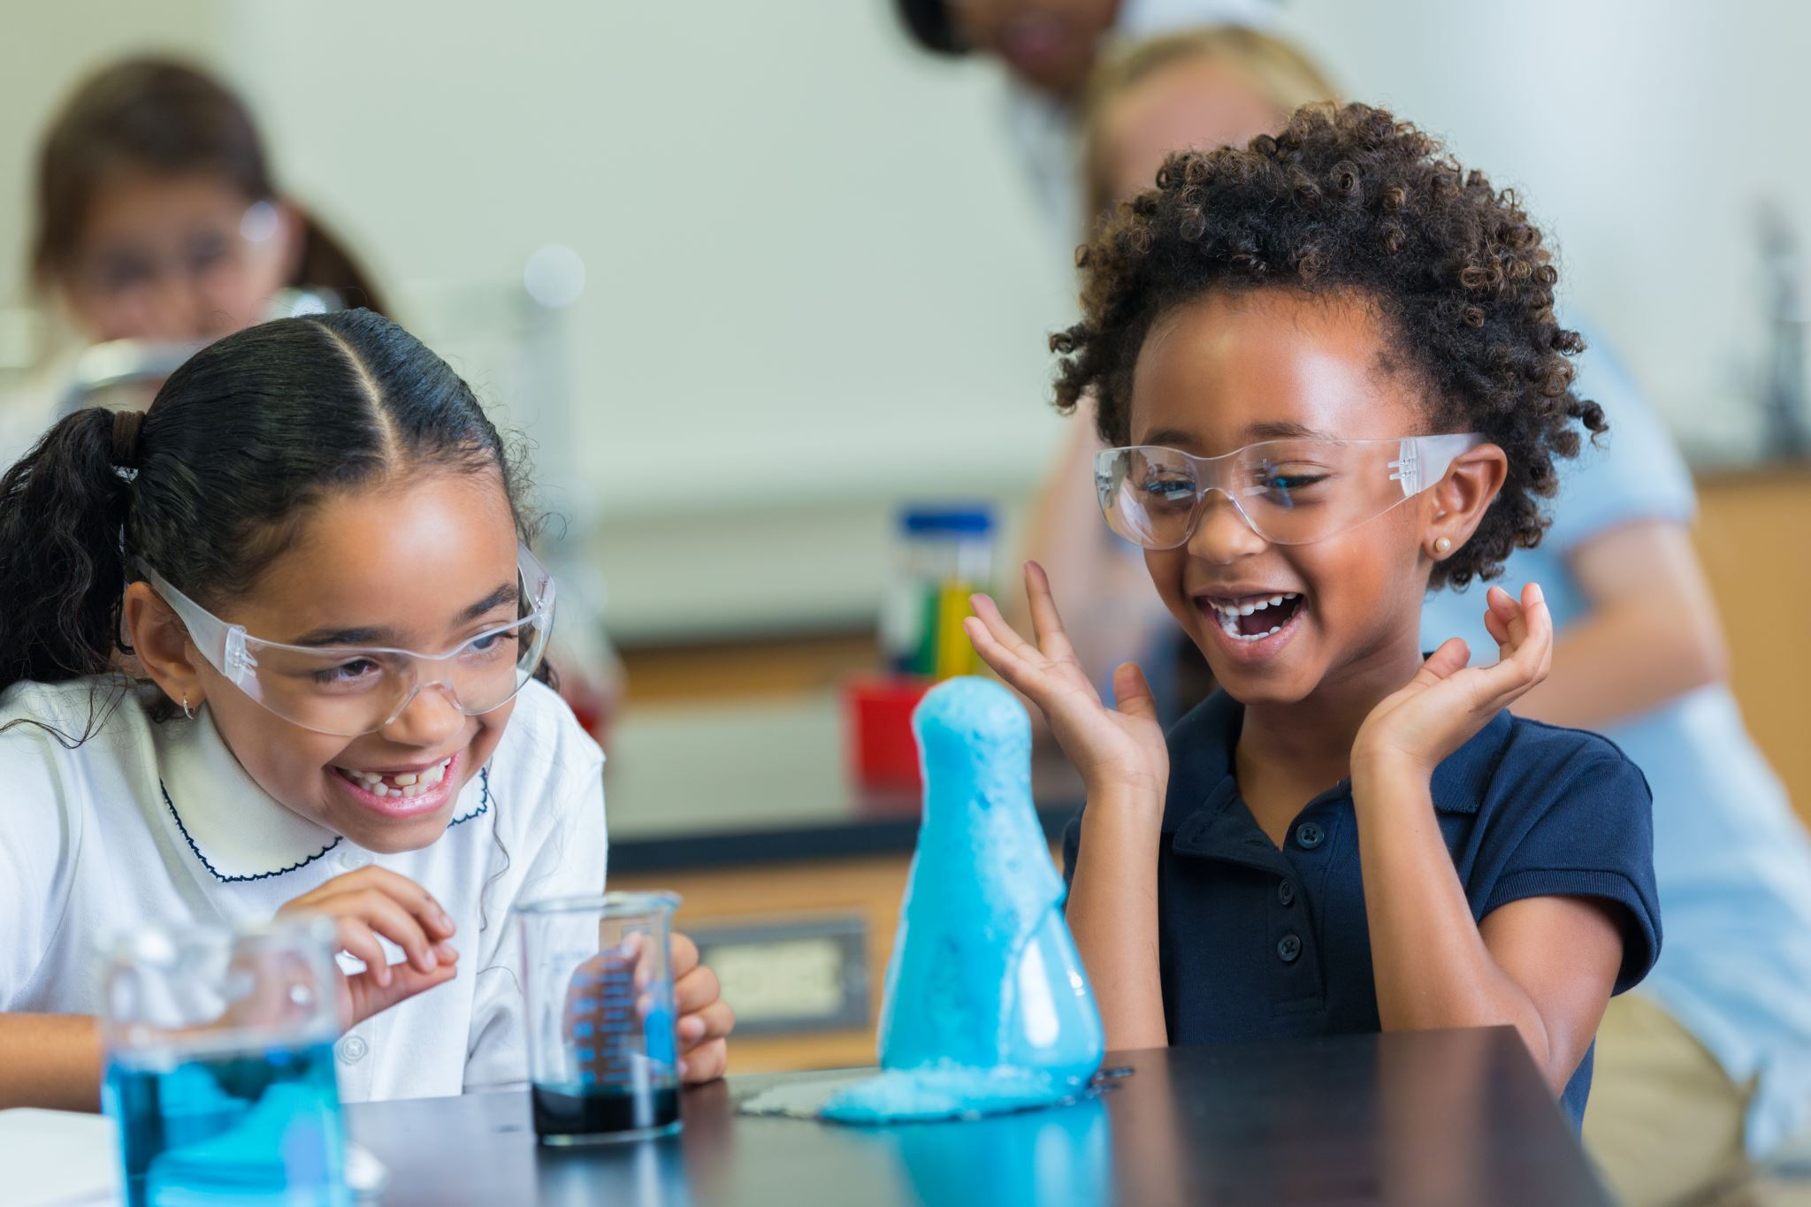
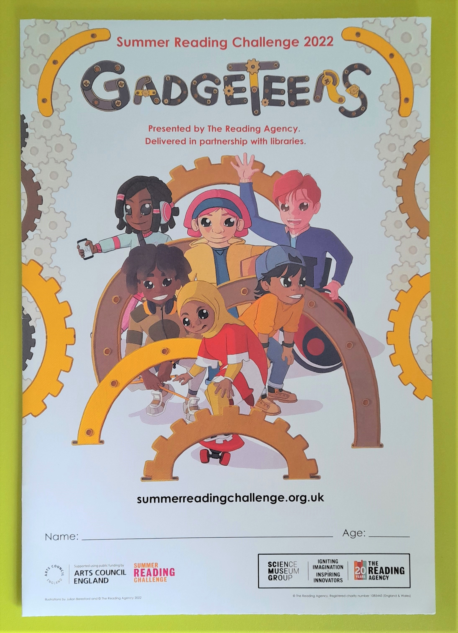
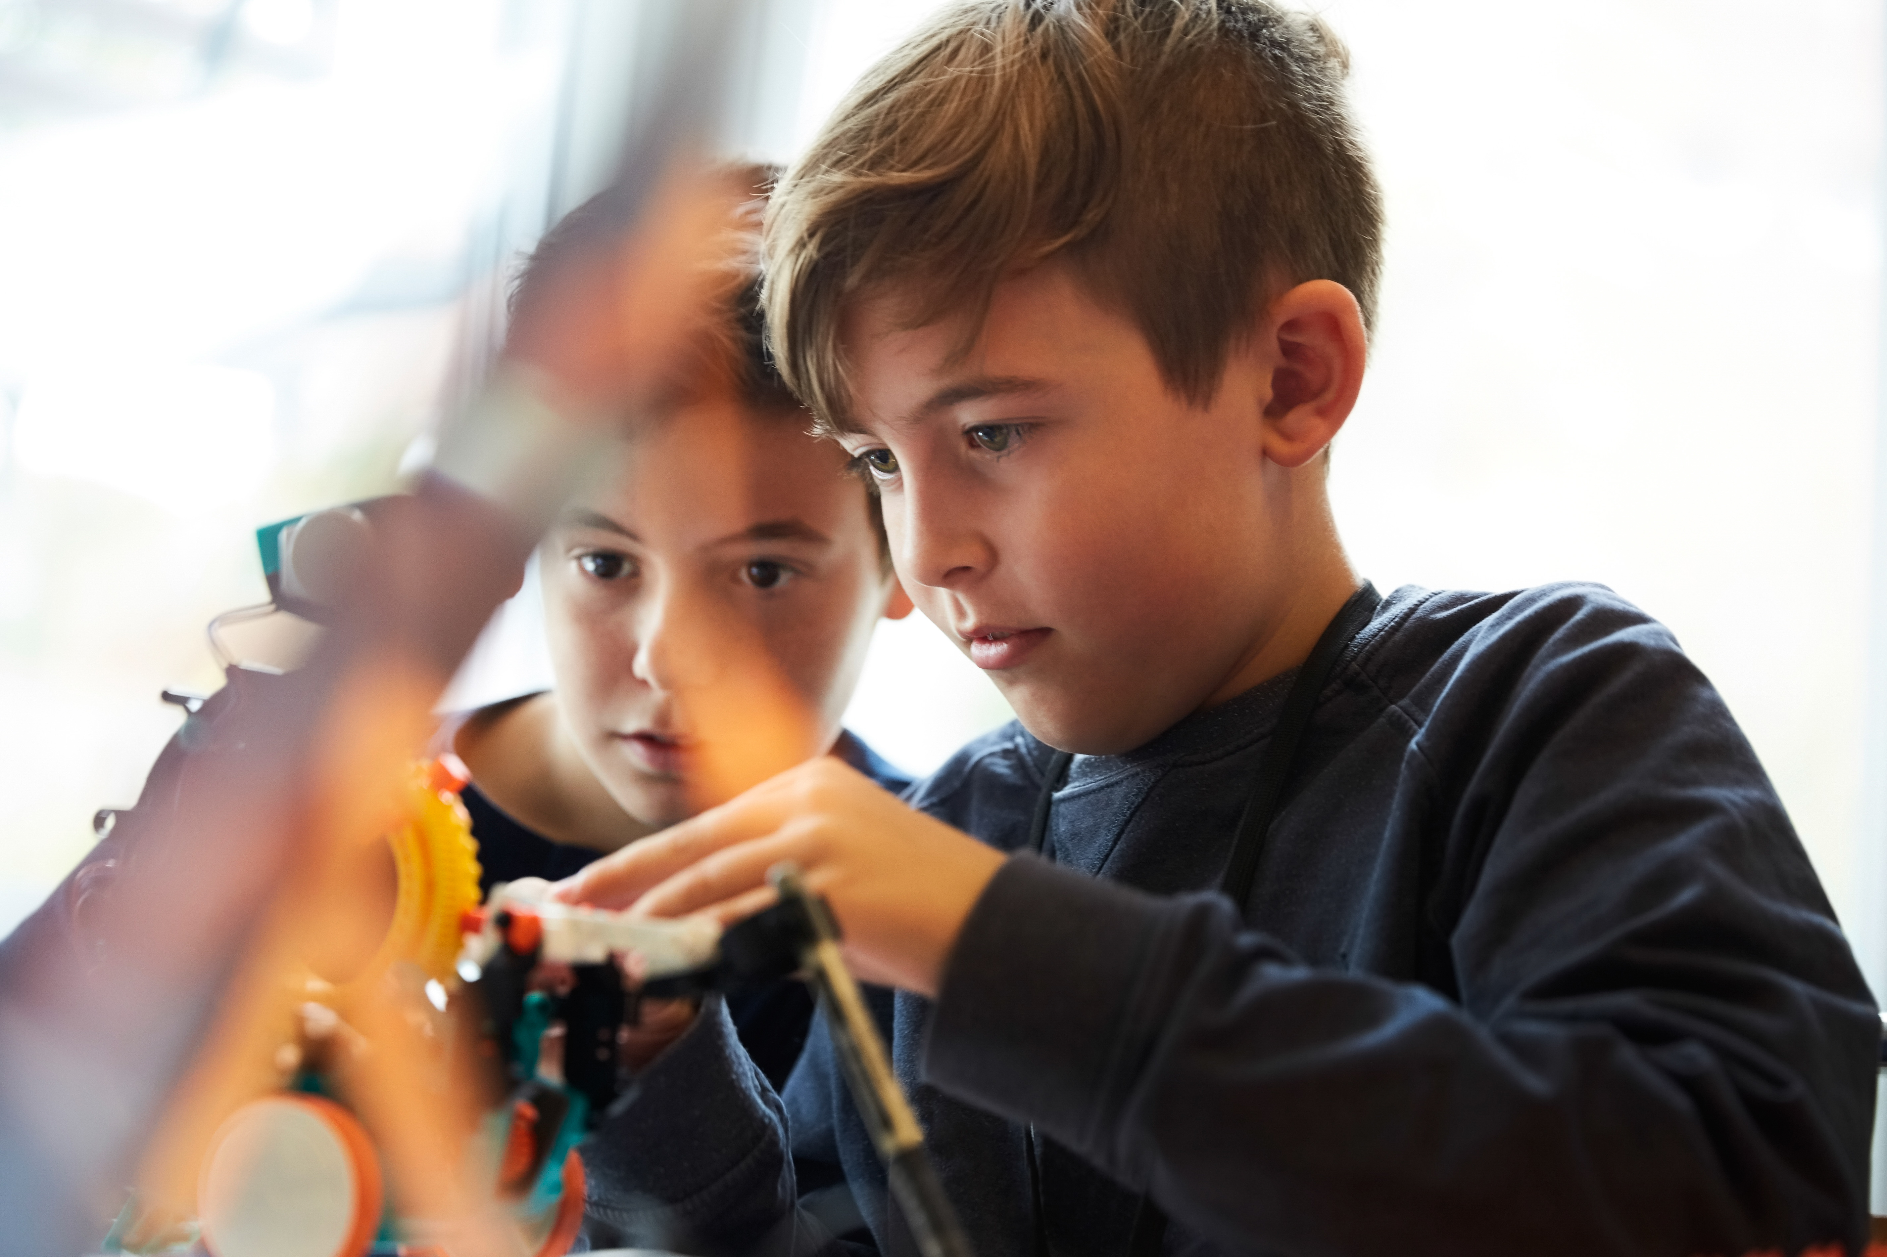
Go to the library this summer to join the Challenge – IT’S FREE!
Sign up to receive your special Gadgeteers collector poster
Choose books to read over the holidays
Collect stickers for each book you read
Add the stickers to your poster to complete the Challenge and become a Gadgeteer!
You'll receive a Core Pack --->
Image from Microsoft 365 2022
Illustrations by Julian Beresford and © The Reading Agency 2022

Slide 4
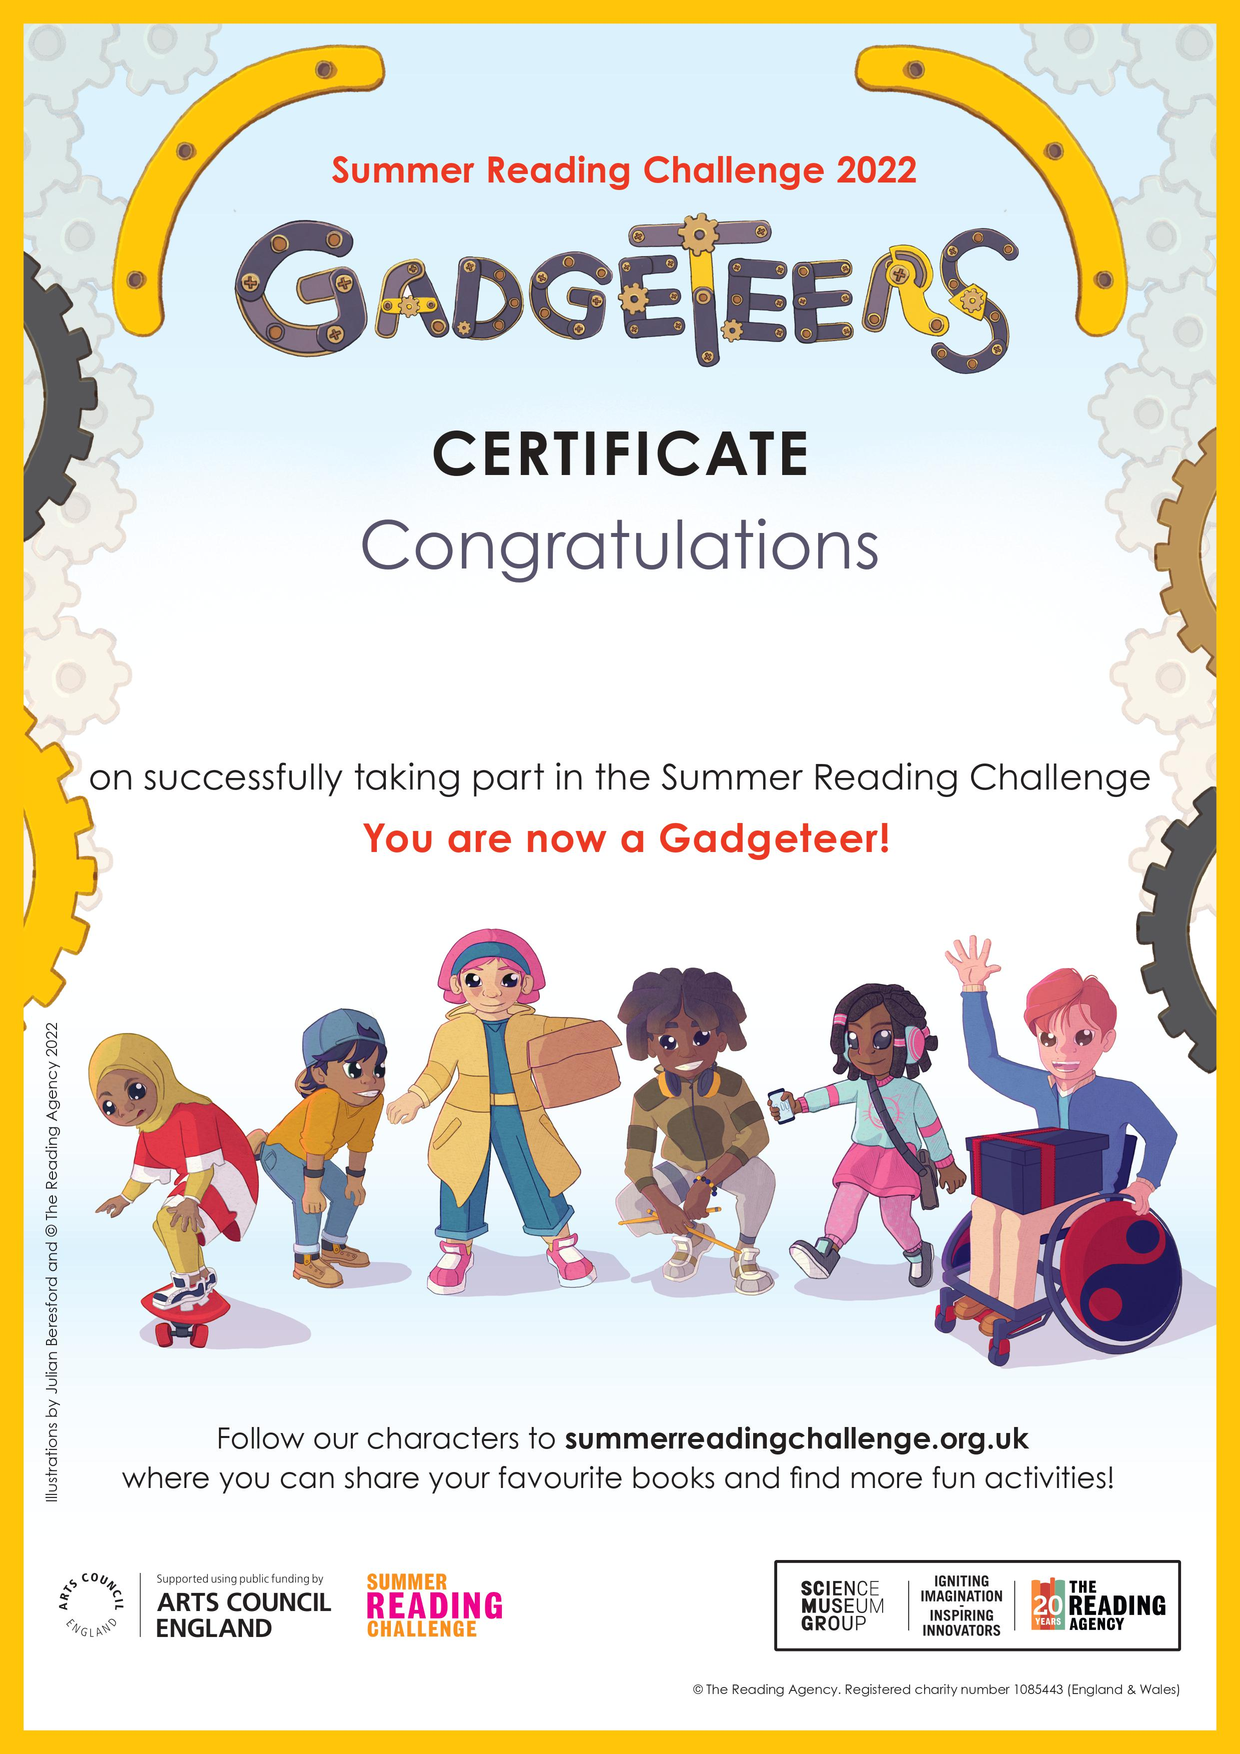
Complete the Challenge and you’ll get a medal and certificate
Illustrations by Julian Beresford and © The Reading Agency 2022
Notes:
Most library authorities will also give medals to children who complete the Challenge, but not all. Please check with your local library service. ​

Slide 5
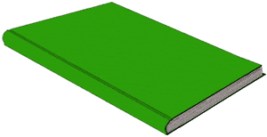
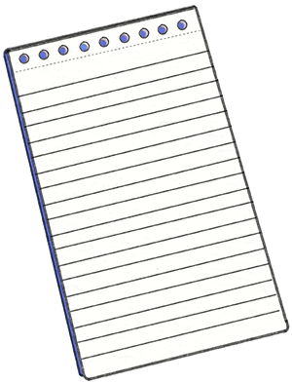
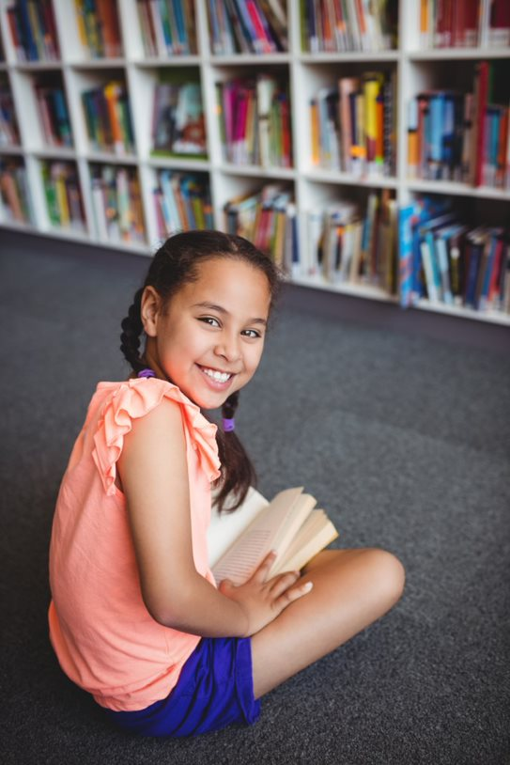
Take part this summer
Gorebridge library
Sign up from Saturday 25th June
Take part in our free activities all summer
Image from Microsoft 365 2022
Illustrations by Julian Beresford and © The Reading Agency 2022
Notes:
Are you ready to become a Gadgeteer?

Slide 6
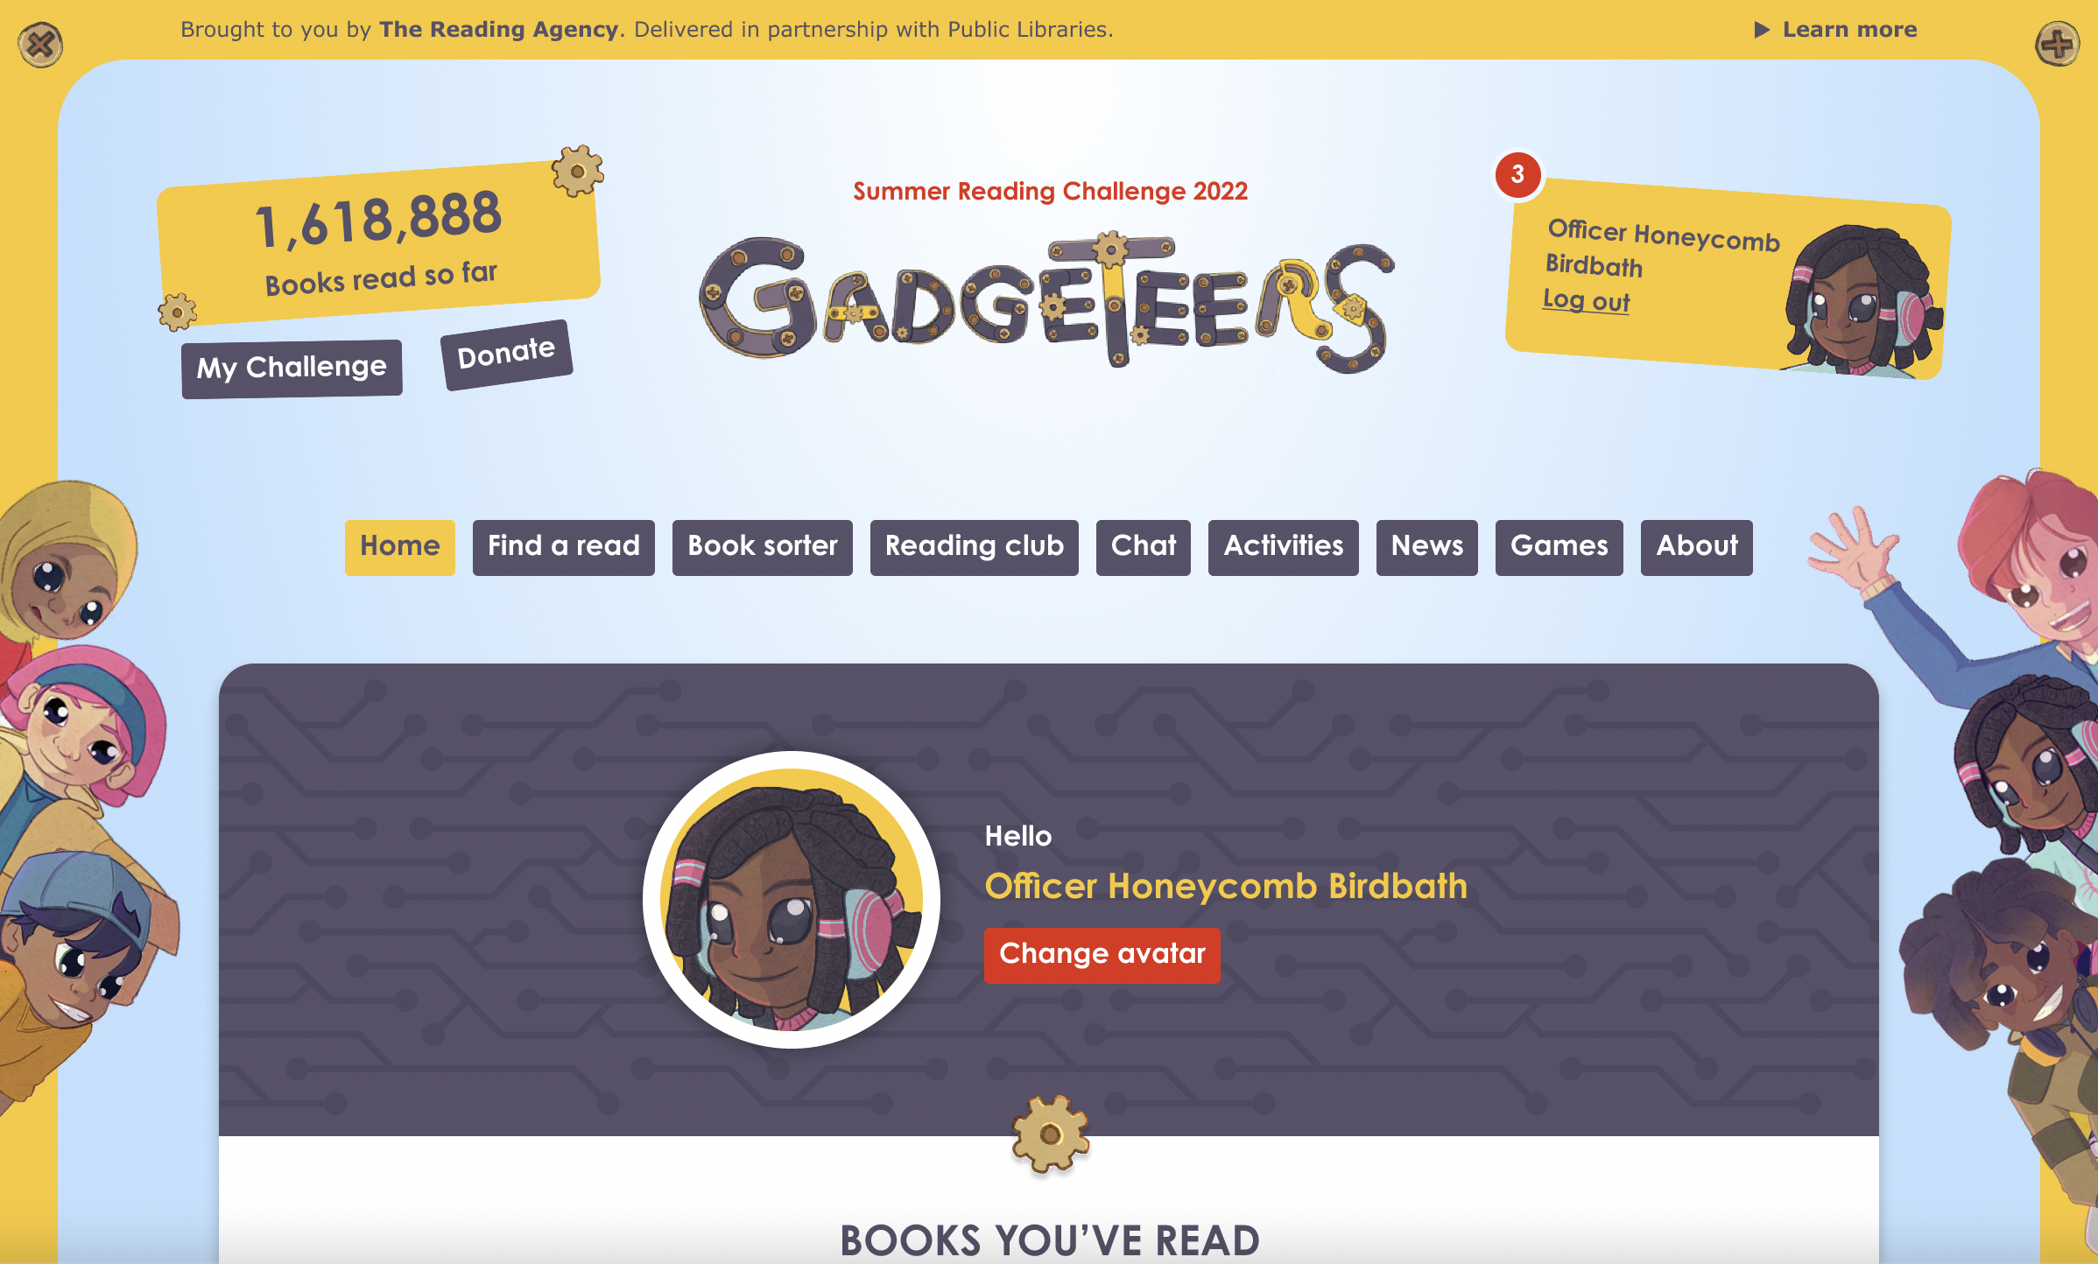
Visit the website
summerreadingchallenge.org.uk
Set your own summer reading goal
Rate and review your books to unlock badges
Play games and enter competitions
Enter the codes printed on your stickers to unlock extra rewards
Use the Book Sorter to find books recommended by other children
Illustrations by Julian Beresford and © The Reading Agency 2022
Notes:
The fun continues at home too! Visit the Gadgeteers website to play games, review your latest reads and enter competitions to win amazing Summer Reading Challenge prizes. You can share your favourite books with other children taking part in the Challenge and even unlock extra rewards for your reading.

Slide 7
See you at the library!
Illustrations by Julian Beresford and © The Reading Agency 2022

