Slide 1
Welcome Primary 1 – 2020/2021
St. Andrew’s RC Primary School, Gorebridge

Slide 2
Your P1 Teacher is... Miss Stewart
Hello boys and girls!
My name is Miss Stewart, and I am going to be your teacher when you begin Primary 1. I am looking forward to meeting all of you and having you as part of my class.
I know lots of you will be very excited for starting P1, but some of you might be quite nervous too. That’s okay, it’s normal to be nervous but I promise to make you feel safe and secure in the classroom as soon as you enter.
P1 will be full of lots of new experiences for you. You’ll be able to meet lots of new friends, take part in different lessons and begin to learn things you couldn’t do before. You will get to learn lots of sounds to help you read and write, work with lots of different numbers and develop your counting, and continue to learn about the world around you.
You will have lots of opportunities to play with the other children in your class; we always make sure that there are a lot of activities you can choose from; from the sand, to the water tray, to drawing, to the cars and building blocks – there’s lots of learning everywhere!
I know that your P1 will look a little different to how we all imagined it, but I know that we can all work together to make your first year at school a successful one.
Looking forward to meeting you all!
Miss Stewart

Slide 3
A Note To Parents and Carers
Dear Parents and Carers,
I understand that your child will not be starting Primary 1 in the way that you had hoped, and that you may have some concerns and anxieties around this.
I understand that for some these times can be quite unsettling, but I wanted to take the opportunity to ensure you that I will do everything in my power to give your child the P1 year that they deserve.
My aim is always to ensure a safe, calm and nurturing environment for the children in my care. I pride myself on the level of pastoral care I give and understand the importance of this, particularly in this year.
I want to reassure you that when your child enters my classroom, they are in safe hands and I will endeavor to create a stimulating learning environment whilst keeping to the rules re physical distancing, personal hygiene etc.
I hope that throughout the year I can build a good relationship with both you and your child, ensuring that we work together to create the best possible opportunities for all learners.
I look forward to working with you all.
Take care,
Miss Stewart

Slide 4
What will my visit to P1 look like?
This year, the P1 visits are going to look very different.
You will be welcomed at the classroom door by Miss Stewart, who will let you in and show you your new classroom. You will sit on the carpet for a quick chat and get the chance to get to know her.
You will then have the opportunity to play in your new classroom.
After a while it will be time to go home. An adult will pick you up from the classroom door.

Slide 5
What should I bring with me?
Due to the current climate, we ask that you bring as little as possible with you. Your visit won’t be for long, so you shouldn’t need anything with you. It might be a good idea to bring clothes suitable for the weather, as you may have the chance to play outside.

Slide 6
Can an adult come with me?
Unfortunately, an adult will not be able to come in to the classroom with you. This is so that we can make sure that everyone, including you, is safe.
Instead you will be asked to stand with an adult in a designated spot in the playground. A member of staff with then come to collect you to take you into your new classroom. Don’t worry, you’ll get to see your adult soon!

Slide 7
Is there anyway an adult can see my school and classroom?
The good news – YES THERE IS! Please use this link here; it will take you to a virtual tour of the school. The classroom set up will look a little different when you’re in, but it’ll give you and your adult a good understanding of what the building looks like.
https://www.thinglink.com/video/1319982198408871938

Slide 8
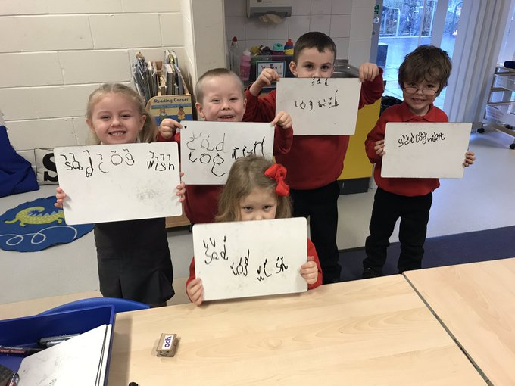
How do I know if I am ready for P1?
Don’t worry about ‘being ready’ for P1. You’ll be prepared in lots of different ways, you just don’t realise it yet.
Don’t worry if you can’t say your numbers or recognise your letters yet; that’s what P1 is for.
Have a look at the list here: it’ll give you ideas of some of the things you can work on before coming into P1.
Can I dress myself?
Can I go to the toilet on my own, and clean myself properly afterwards?
Can I use a knife and fork correctly?
Can I use buttons and zips?
Can I put my shoes on, on my own?
Can I put on/take off my jacket and hang it properly on a peg (on my own)?
Can I pack/unpack my bag?
Can I put things away in the correct place?
Can I recognise my name, and the names of my friends?
Can I write my first name, without support?

Slide 9
Questions...
If there is anything else you would like to ask, remember to contact the school by phoning 0131 271 4670.
Alternatively you can email the school on standrews_ps@midlothian.gov.uk
Remember to follow @StAndrewsTweets and @MissEssTweets on Twitter!

