Slide 1
Rosewell Primary School
Digital Devices Parent/Carer Meeting
Wednesday 6th April 2022

Slide 2
Equipped for Learning:
The ‘Equipped for Learning’ initiative is the council’s £10.5 million project
Midlothian is the first local authority in Scotland to launch a digital learning project on this scale, supporting children and young people from Primary One to Secondary Six with digital access

Slide 3
Equipped for Learning:
The project aims to:
Provide a safe, secure and inclusive learning environment that all school age pupils can access equally
Give pupils the tools to take greater responsibility for and ownership of their learning with the ability to access materials on their device at anytime from anywhere
Technically support the opportunities and demands of remote learning if required or as planned for senior learners
Use the platform Google Workspace to help pupils and staff develop digital skills for life and work

Slide 4
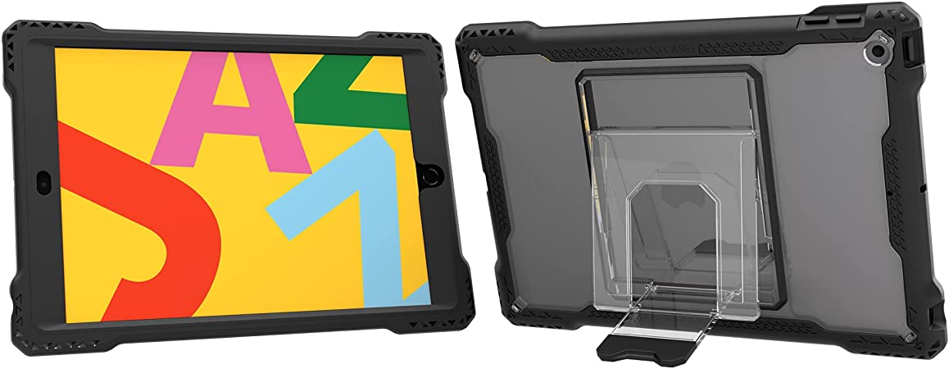
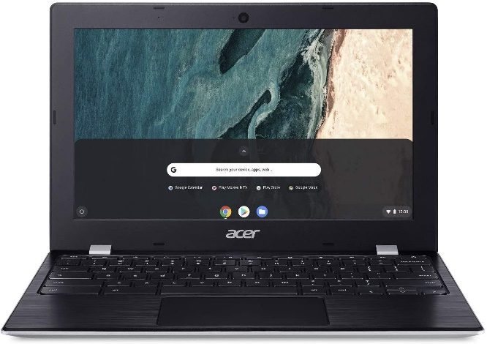
The device deployment:
Primary 1 and Primary 2 have received iPads
Every iPad is protected within a tough case and is supplied with a charger
Primary 3 to Primary 7 have received a Chromebook
Every Chromebook is supplied with a zipped protective case and a charger

Slide 5
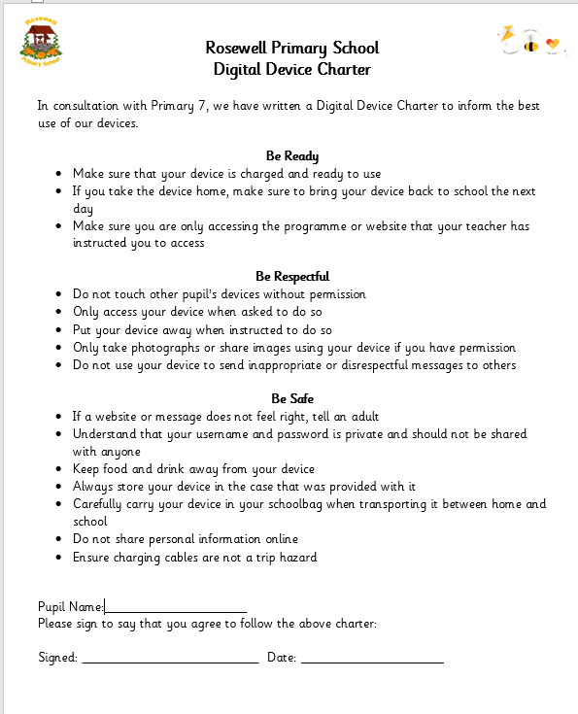
Device Use:
P7 worked collaboratively using Jamboard to suggest rules and expectations for safe and fair device use
We used our school expectations to organise our Digital Device Charter
This has already been shared with other schools as a example of best practice

Slide 6
Moving on…
P7 will take their Chromebook onto S1
P6 will be allocated new Chromebooks
Current P6 Chromebooks will be re-allocated to our new P3 cohort
iPads will be reallocated to our new P1 cohort
This ensures iPads remain in the early years and Chromebooks are available for all P3 to P7

Slide 7
Our current device use:
iPads, Chromebooks and PCs were already available in school to support learning
Some identified pupils were already allocated a device to support their access to learning eg for fine motor, literacy support etc.
Read&Write Extension – to support digital access
IDL – identified learners use IDL daily to support literacy skills
Google Workspace – access to word processing, spreadsheets, presentations
Identified learning websites and apps including Sumdog, YouTube

Slide 8
Questions
Will devices come home?
All learners have permission to bring devices home
Can be used to access online learning eg Google Classroom
Consider the best way to transport it between home and school
Initially, home on a Friday and brought back to school on a Monday

Slide 9
Questions
Do devices need to come home?
Home learning is currently shared via Google Classroom
If you are happy accessing this via a personal device, you may opt to leave your child’s device in school
Devices have been provided to ensure equity for all
Devices can be taken home for the Easter holiday to allow for familiarity and troubleshooting home access

Slide 10
Questions
Will devices reduce the amount of writing in school?
We still value written tasks and will encourage this where appropriate
In preparation for High School, our senior classes may utilise devices more regularly
Younger classes will still practise letter formation
Devices allow for collaborative learning activities eg Jamboard

Slide 11
Further Questions
Mrs Muirhead is our Digital Co-Ordinator within school working alongside the digital team
A visiting Digital Technologist to support device use and to extend our digital learning
Additional questions can be added to our Google Form (shared within the email inviting you to this meeting) or can be emailed to our school office
Caveat! We may not always know the answer but we will ask the Digital Team on your behalf

