Slide 1
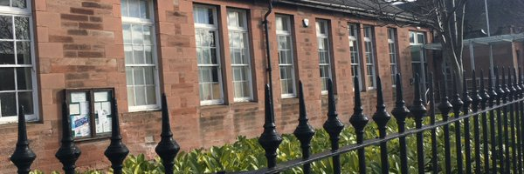
Welcome to Rosewell Primary
22nd September 2021

Slide 2
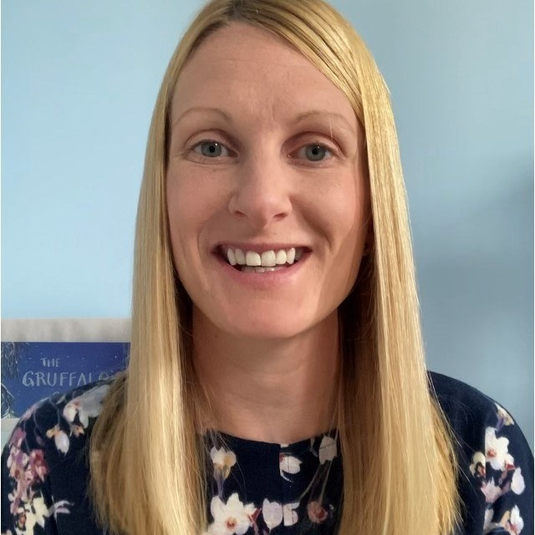
Mrs Moffat and Mrs Clark P1
Notes:
Each teacher to introduce themselves

Slide 3
Practical Points
Encourage your child to be independent eg. Packing/unpacking own bag, handing over letters
Indoor shoes
Please label everything!
Regular handwashing throughout the day
Notes:
D

Slide 4
Literacy at Early and First Level
Phonics and Spelling linked to Read Write Inc.
Weekly opportunities for extended writing lessons
Opportunities for Book/Author studies
Handwriting lessons – correct letter formation
Notes:
L
Explain revision of sounds from P1 – middle blends.
Word walls from RWI
Writing based on personal experience – diaries and functional writing – posters

Slide 5
Literacy at Early and First Level
Group Readers – developing reading skills
Rosewell Tricky Words Lists – from P1
Grammar taught through reading and writing and as a stand alone when required
Writing linked to IDL and stand alone genre
Notes:
L
Explain revision of sounds from P1 – middle blends.
Word walls from RWI
Writing based on personal experience – diaries and functional writing – posters

Slide 6
Numeracy & Maths at Early and First Level
Following MUMP Progressions
Taught through practical application (SEAL) and activities as well as written tasks, games and ICT activities
Talking about how they got an answer/ strategies used
Notes:
K
Explain about MUMP and resources used
Talk about examples of games used to consolidate skills and use these in a practical and real experience
Interdisciplinary links – shopping and money

Slide 7
Numeracy & Maths at Early and First Level
Links to our IDL work –e.g. money and shops
Basic Maths Facts
Sumdog - online
Maths Week Scotland – a focus for the whole school
Notes:
K
Explain about MUMP and resources used
Talk about examples of games used to consolidate skills and use these in a practical and real experience
Interdisciplinary links – shopping and money

Slide 8
IDL (Interdisciplinary Learning) at Early and First Level
May have a main focus of Social Subjects or Science e.g Rosewell
Links to Outdoor Learning
Links multiple curricular areas for breadth of coverage and application eg numeracy skills linked to weather
Notes:
D
Using a working wall to find out about what they know already and what type of things they would like to know about.
The children have the opportunity to lead the learning.
The topics are flexible to allow us to explore current affairs or things which the children show an interest in.

Slide 9
Health and Wellbeing
School values: Work Hard, Be kind, Be Confident
School expectations: Ready, Respectful, Safe
2 sessions of PE
Bubble Box & HWB Webs
Emotional, Physical and Social- e.g. Healthy Eating, Friendships, Medicine Safety
Notes:
L

Slide 10
Parental Engagement
Online Learning Journals – your contributions are very valuable and appreciated
Friday Feedback, School app, Twitter
Termly Overviews to share our learning
Notes:
K

Slide 11
Learning Profiles
Shared regularly
Targets and Next Steps set
Learning as well as Wider Achievement
Ongoing assessment –brief end of year report
Notes:
K

Slide 12
Homework
Reading
Library Books
Oxford Owl
We encourage children to aim for at least 20 minutes reading each evening
Spelling
Active spelling tasks – linked to sounds and spelling patterns being taught
Numeracy
Numeracy tasks will be set using Sumdog or other websites
Notes:
D

Slide 13
Thank
You

