Slide 1
Promoting Positive Post-Pandemic Mental Health Top Tips for Parents
Fiona Brown
Midlothian Council Educational Psychology Service

Slide 2
3 Key Themes
Responding to the new normal
Building resilience
Listening to children

Slide 3
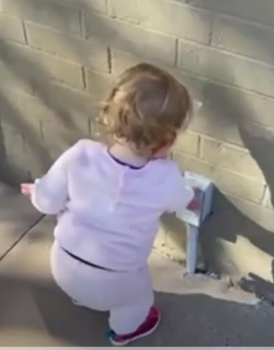
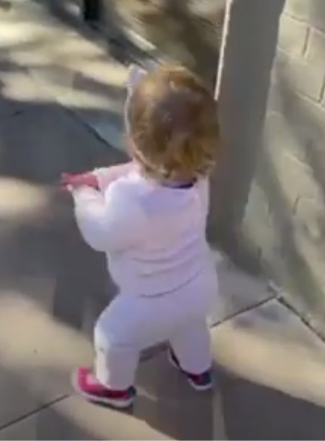
Returning to “normal” – how do we feel?
https://www.youtube.com/watch?v=sN_TMgf5Ogg

Slide 4
Impact on children and young people
“Rusty” social skills
We’ve been in the same sea – but not the same boat
Different narratives around the pandemic/opening up

Slide 5
How can I help my child?
Normalise (don’t pathologise)
Take it slow
Build new routines
Help your child become resilient

Slide 6
Developing resilience
“hope and optimism in the face of adversity” Michael Rutter
Bouncing back
Developed through managed exposure to risk – learning how to cope

Slide 7
Locus of Control
Things I can control
Things I can influence
Things over which I have no control

Slide 9
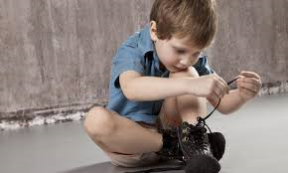

Slide 10
Individual Level
“controlled exposure”
To risk
To challenge or unpleasant events
Give developmentally appropriate roles and responsibility
Teach problem solving skills
Develop emotional literacy
Teach interpersonal skills
Co-operative learning skills
Social skills
Conflict resolution skills
Develop relaxation strategies
Celebrate achievement

Slide 14
Foster independence
The more children bounce back on their own, the more they internalise the message that they are capable

Slide 15
“Listen with an intensity that most people save for talking”
Lily Tomlin

Slide 16
Active Listening
Is Non-judgmental
Empathic
Taking the time and adjusting pace of communication to match the speaker
Validating emotions- allowing people to have their feelings regardless of what these are
Summarising
Checking back on understanding of the situation and the feelings that are generated
Asking questions rather than providing ‘solutions’ or ‘interventions’
Is not
About the listener rather than the speaker
Giving advice
Passing judgment
Trying to fix difficult feelings/problems

Slide 17
Be available
“The quieter you become, the more you can hear” Ram Dass
Worries, things to talk about – thoughts come and go at any minute of any day therefore when your child needs to talk might be at a different time to when you expected
Create space to talk and listen
Side by side activities – baking, playing, lego, craft
Car journey
Walks
Model – if you think something is on their mind, share something that’s on yours – model how to talk about it and how it feels to talk about it- e.g. the power in verbalising/articulating out loud, how helpful it can be

Slide 18
Listen to the non-verbal
Behaviours that may be a sign of hidden anxiety
Regression in self care skills
Bedwetting or daytime accidents
Tummy/head pains
Seeking reassurance
Overly routinized – sticking to same foods, clothes, tv shows
Seeking reassurance
Nightmares or disrupted sleep pattern

Slide 19
Other things that help
Sleep
Coping strategies Connecting with others
Helping others
Exercise and good food

Slide 20
Top tips for better sleep
Try to get up at the same time every day
Get outside as early as possible
Exercise every day
Evening routine
Avoid caffeine (coke, chocolate)
No devices/screens for 1-1.5 hours before bed
Low lights
Debrief (if it helps)
Focus on rest, not sleep

Slide 21
The key to family wellbeing

Slide 22
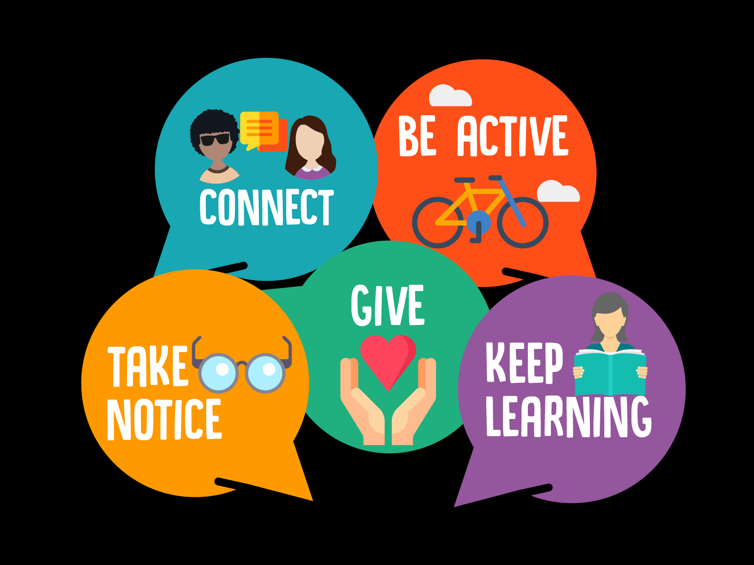
Resources
reach.scot

