Slide 1
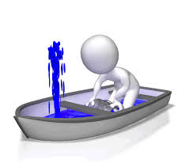
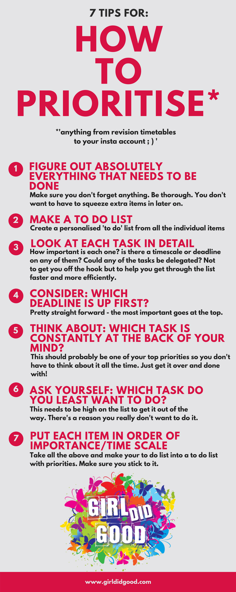
Prioritise your time
If you've got more than one exam to tackle, draw out a simple diagram with dates of each exam and how many topics need covered for each. This will give you a clear idea of how much time you need to dedicate to each exam topic and when you need to get started on your revision, so there won't be any nasty surprises.
As you progress through your revision, tick off the topics that you've completed – this will give you a small sense of achievement, knowing that you've finished something and are making your way to the finish line.

Slide 2
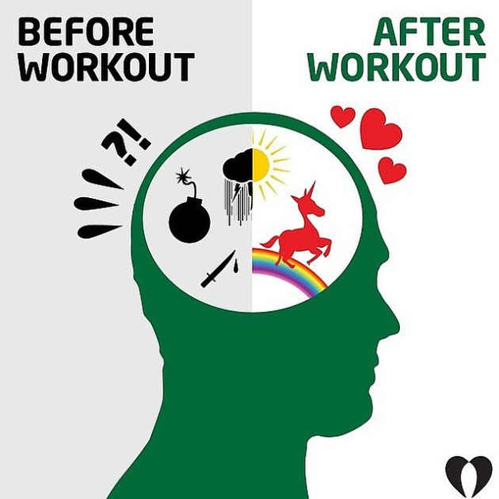
Exercise
Yeah, we know, you're exhausted. Sometimes the idea of exercising during times of high stress feels like the last thing you want to do, but we guarantee you will feel better afterwards (and could even have a bit more energy to do an hour more revision afterwards if you're feeling up to it).
Exercise gets your blood flowing and your heart pumping – the result being that you sort of 'wake up on the inside'. As a result, once you stop, you're much more alert then you were before.
Give yourself that push to get out for a run, go to the gym or just do a short work out in your bedroom. Exercise is a proven stress buster as it fills your brain with endorphins, which are basically happy hormones.

Slide 3
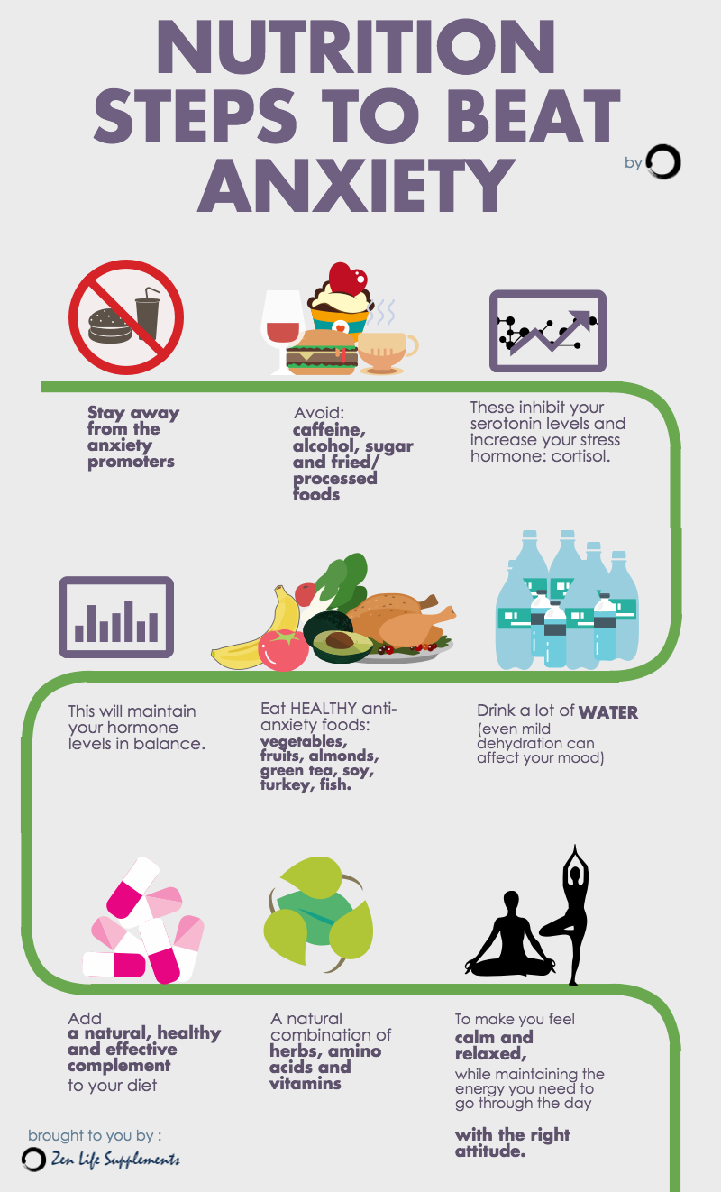
Eat well
Eating the right foods during stressful times is also absolutely crucial for mental health – eating the right foods can not only reduce stress, but they also increase brain power!
Treat your body like a temple and fuel that brain. It’s mostly true that you are what you eat. Have plenty of fresh fruit, vegetables on a daily basis and make sure you have a good breakfast every day. No one can think properly if they’re running off sweets and coffee.

Slide 4
Avoid social media
This will be a tough one for many students, but if you can bear to part with your beloved Instagram for a few days, it'll do wonders for your stress levels.
Checking your Facebook during revision period is the worst type of procrastination possible, as we all know how quickly the time disappears when you're snooping on your news feed.
In addition to this, many of your friends will be in the same boat, so are likely to be talking a lot about how much they're studying (or not studying). This is likely to stress you out even more, or at least influence how much time you're spending revising.

Slide 5
Give yourself a break
This is perhaps easier said than done, but try not to give yourself such a hard time. You're doing your best and that's the best you can do!
Putting yourself under a lot of pressure will only have a negative effect, and as much of a cliché as this is, worrying really doesn't solve anything.
Being good to yourself during periods of high stress is likely to give you a bit more motivation to work harder.

Slide 6
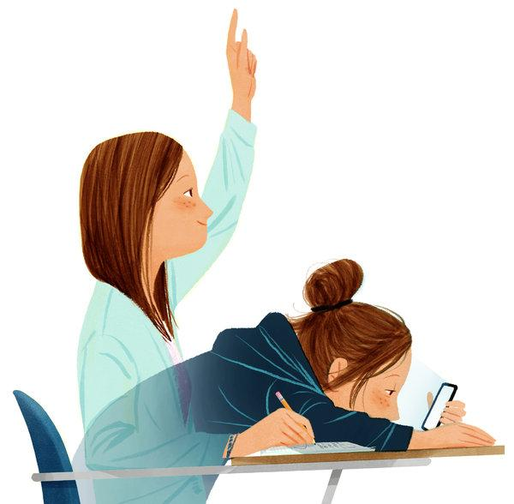
Sleep well
For your body's best performance, make sure you're getting 8/9 hours of sleep, studying for long hours is tiring. When it cuts into your usual hours of sleep, research shows us that stress levels will increase.
Stress and sleep have a two-way relationship. Stress can make it more difficult to fall asleep. It can even lead to sleep disorders.
At the same time, getting a good night’s sleep reduces the effects of stress.
Practise these tips to get a good night’s rest every night:
Try to go to sleep and get up at the same time every day. This helps to set your body’s internal clock and optimises the quality of your sleep.
Avoid sleeping in, even on weekends. Aim to keep your sleep schedule as regular as possible. If you have a late night, try taking a short nap the following day, rather than sleeping in.
Keep your electronic devices out of your bedroom. The blue light emitted by your electronic devices (e.g. phone, tablet, computer, TV) is especially disruptive to sleep.
Wind down before you go to bed. Turn off all your devices an hour before it’s time to sleep. Read a book, listen to some calming music or think of a happy memory.

Slide 7
Don't go it alone
In 2004, a research paper published in Linguistics and Education saw that revising with peers is an effective study technique as it allows individuals to better absorb their own notes. Furthermore, the emotional benefits of social support tend to include a better sense of confidence and autonomy.

Slide 8
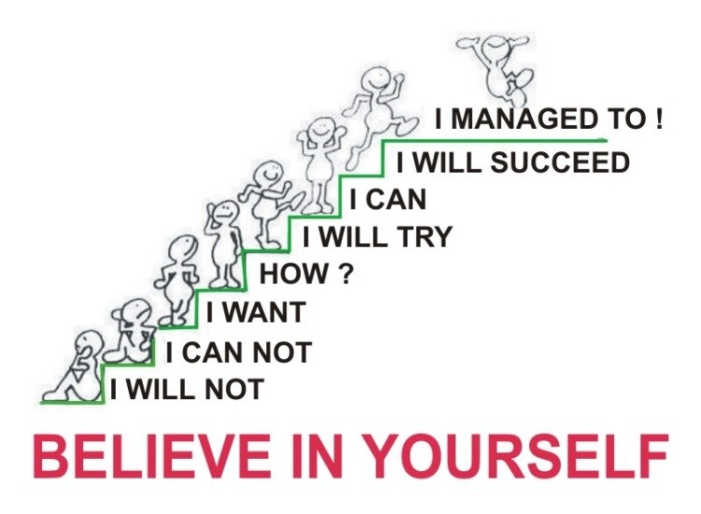
Believe in yourself
When being constantly faced with new challenges, we often forget to look back at how far we have come and how much we have already achieved. Given that you have prepared well, there should be no reason for you to worry. Therefore, when experiencing a negative thought, try to replace it with a positive one. For example, instead of thinking 'If I don't get at least a 60%, I am a failure', think 'Whatever I get, I will be proud of myself and value how much I have already achieved'. You can do this!

Slide 9
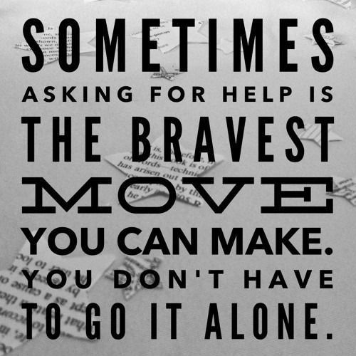
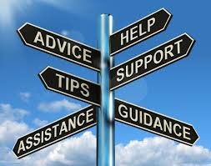
If you feel like you are struggling, talk to someone
Asking for help is never shameful. In the most extreme cases, it can help save a life. When struggling, talk to friends, family, or your guidance/teacher about how you are feeling.

Slide 10
Avoid Caffeine
Caffeine is a stimulating substance which has a number of physiological effects on the body, including a slight increase in blood pressure and pulse. It has been proven to worsen symptoms of panic and anxiety, and it can interfere with sleep which in turn will make you more irritable and unfocused. No caffeine after 4 or 5pm is a good rule to follow. Remember that chocolate also contains a small amount of caffeine.

