Slide 1
Curriculum Evening Primary 6G/P
Mrs Vicky Gowans
Mrs Emily Paton
“Reach your Potential
Be the Best you can be”

Slide 2
Term 1
Novel Study – Harry Potter and the Philosopher’s Stone
Enjoyment, comprehension, character/plot/setting, writers style
Reading for enjoyment and book talks
IDL topic – Solar System
Writing – reinforcing VCOP (vocabulary, connectives, openers and punctuation)
Classroom ethos – Respect, Tolerance, Empathy
Develop skills for learning – collaboration, perseverance, concentration etc

Slide 3
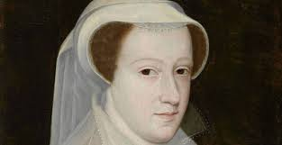
Term 2
IDL topic: Mary, Queen of Scots
Focus on historical facts, literacy skills and
expressive arts
Scottish Book Week (W/C 27.11.17)
Continue to reinforce skills for learning
RME topic on Holy Books

Slide 4
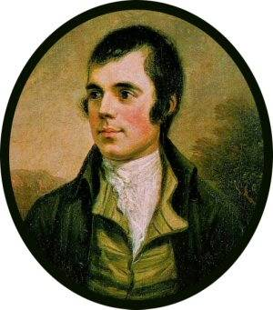
Term 3
Scot’s week
HWB – Sex Education
Maths & Numeracy Week
Science focus:
Friction and air resistance
Electrical circuits
Filtration and separation of materials

Slide 5
Term 4
IDL topic – Scottish Parliament
Focus on democracy in practice and literacy skills
RME topic - Sikhism
HWB - Keeping Myself Safe
Sports Day
Notes:
Topic focus: Use of evidence about the past, chronology, learning through drama (as a stimulus to writing)

Slide 6
Literacy
Resources and approaches:
Reading
Novel study
Literature Circles
Focus on reading for enjoyment
Focussed comprehension:
Prim Ed comprehension
Topic linked reading
Writing
Big Writing Programme
Different genres of writing throughout the year, linked to topic were appropriate
SWST and linked spelling lists/Spelling linked to topic
Midlothian grammar progression
French ongoing throughout year

Slide 7
Numeracy & Maths
SEAL
Teaching for understanding
Understanding process as well as ‘getting it right’
Resources
MUMP – Midlothian Understanding Mathematics Programme
Midlothian problem-solving resources and progression
SEAL resources – concrete materials
ICT Activities – to consolidate key learning
Consolidation sheets and textbooks

Slide 8
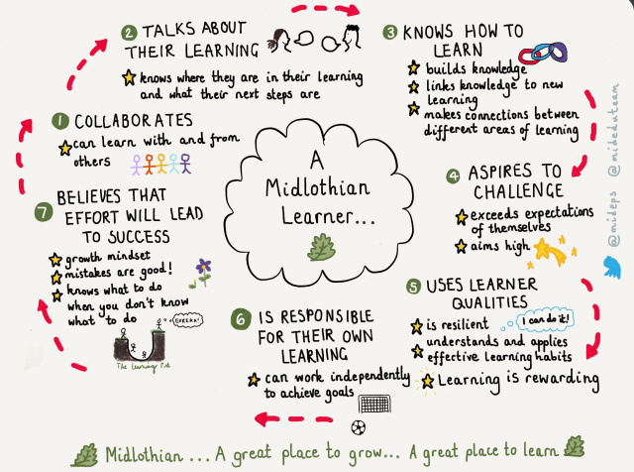
Midlothian Learner
‘Assessment capable learners’
Understand purpose of learning and can assess their progress
Use feedback (self, peer, teacher) to move pupil’s learning forwards

Slide 9
Home Learning
In the near future, the upper atrium will issue a monthly homework grid via Seesaw whereby learners and their families can carry out a range of activities and share it with their teacher.

Slide 10
How you can help?
Keen to work in partnership with families to support learning, behaviour and progress.
Stay in touch – If there is an issue, lets discuss this at the earliest possible time.
Help your child to stay organised
Reminding your son/daughter to complete home learning.
Pencil case with pencil, rubber, sharpener, ruler
Water bottle (water only)
Return letters promptly, preferably in envelopes with names on.

Slide 11
Questions
Please don’t hesitate to contact us via Seesaw with any questions you may have.

