Slide 1
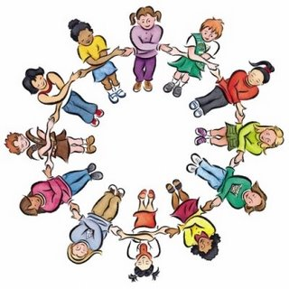
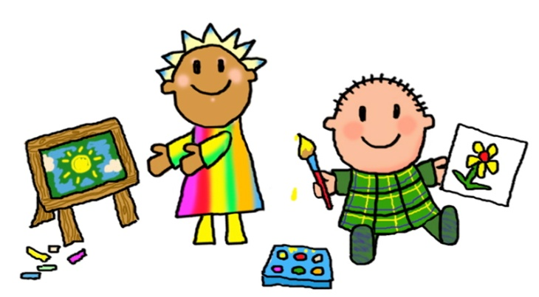
Welcome to P1/2L With Miss Landells

Slide 2
Welcome
Hi Everyone!
This is of course not my usual ‘meet the teacher’ format but I hope this provides you with lots of useful information. The luxury of being a P1/2 teacher in these unusual times is I have already met most of you from a distance at pick up and drop off ☺
I have been at Gorebridge Primary for 7 years now. I have taught across all stages of our school and I am really excited to be working within our infant department again!
I am also lucky enough to be one of the Principal Teachers at our school, meaning I support Mr Wood & Mrs Binnie with School Improvement Planning.

Slide 3
Staff in P1/2L
As you are already aware, on a Tuesday afternoon Mrs Stewart will teach the class and on a Wednesday afternoon it will be Mrs Meikle. We all work closely together on planning teaching and learning experiences for our learners.
We are also lucky enough to have Learning Assistants supporting learning in P1/2L . For now, the adults who will be supporting in our class will be Mr O’Brien an Miss Gavin.

Slide 4
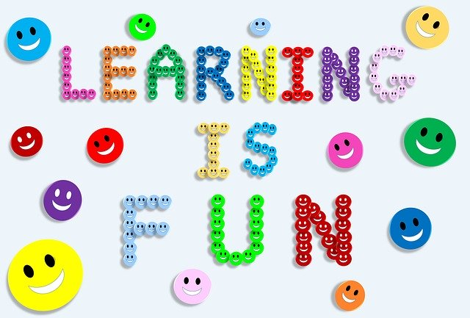
Learning in P1/2L
Literacy P1 – we will be using Read Write Inc for phonics and will learn 3 new sounds a week.
Literacy P2 – we will be using Read Write Inc to support phonics, reading and writing. Some of us will be learning initial sounds, whilst others will be learning diagraphs and word building. We will be familiarising ourselves with ‘dittys’ before moving onto Reading books.
Writing – we will be using the framework of ‘Big Writing’. Which means we will have one writing session in the week but will be continuously developing the tools and skills for writing across all curricular areas throughout the week.
Numeracy – we will be using the SEAL approach (Stages of Early Arithmetical Learning) to numeracy which drills down on the concepts of early number skills and often uses practical materials regularly. We will also be using Teejay Maths resources to further develop our numeracy skills.
Topic – this session we will be learning about our identity, our community and our rights.

Slide 5
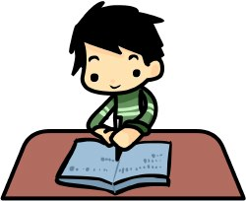
Homework
Please upload completed tasks onto Seesaw, do not bring any homework back into school.
P1 Reading– Read Write Inc sounds will be given out on a Thursday. These will be the 3 sounds that have been taught in class that week. Your child will soon begin reading using ‘dittys’ which are part of RWI and are the first step in learning to read!
P2 Reading – some learners will be recapping sounds before moving onto diagraphs whilst others will already have started with ‘dittys’ and word building.
P2 Spelling – Mrs Meikle will issue Spelling Homework on a Wednesday.
P1 – Spelling – will be issued in due course.
IDL- Some weeks extra homework based on our topic will be given out .

Slide 6
Big Writing
Our writing sessions will be on a Thursday morning. For now, we will be writing personal accounts of real life events. Throughout the year we will be learning how to write across various different genres.
It is important to recognise that we will be using our Listening and Talking skills to support our writing too so investing in ‘time to talk’ at home is just as helpful as reading a book with your child.
Vocabulary will be built in across all curricular areas to help learners develop their language skills which will support writing. Whole class planning will also support writing for all learners.

Slide 7
Sharing Stories
We will listen to stories daily, either read by an adult in class or online. We encourage reading for enjoyment at home also.
This term we have been reading the ‘Colour Monster’ to help us develop an understanding of our emotions.
Every morning we develop our Listening and Talking skills by discussing a picture with a friend and sharing our ideas with others.

Slide 8
P.E.
We will take part in PE with Mrs Stewart on a Wednesday. We won’t be changing into a PE for now due to current guidance.
Monday afternoon or Friday morning will also involve outdoor PE sessions too, this will include game playing, yoga and different forms of exercise.

Slide 9
IDL (Topics this year)
August ‘20– October ‘20: Being Me
October ‘20– December ‘20: The Gruffalo
January ’21 - April ‘21: Hamish McHaggis (Scotland)
April ‘21 – June 21: Living Things

Slide 10
Thank you!
I think that is all for now. I really hope you found this information useful, if you have any questions please do not hesitate to contact me ☺

