Slide 1
Notes:
Add your name and job title
Introduce yourself to class and explain your role within the school as an SDS Careers Adviser.
Explain why you are here in relation to making subject choice.
Explain that the session today is to help them think about who they are, what they like and what they are good at and how all of these factors will relate to their subject choices. It’s their choice – nobody else’s.
Ensure you have enough supplies of ‘Future Me – Subject Choices’ magazine for the group. Quickly show the group the mag and say they’ll each receive a copy at the end of this session.

Slide 2
Notes:
Brief introduction to SDS/MyWoW

Slide 3
Notes:
Recap on CMS:
Career Management Skills are skills for life empowering us to strengthen our understanding of the four themes: Self, Strengths, Horizons and Networks. They help us to make informed decisions and realise our potential at any point. If you feel confident that you have a good understanding of these four themes and can demonstrate this then you will be well equipped to cope with developing your career.
The four areas are:
SELF is about
Understanding who you are and what you like
STRENGTHS is about
Understanding what you are good at
HORIZONS is about
Understanding what options might be available to you
NETWORKS is about
Understanding who can help you, and how.
At this stage (preparing for subject choices this year) we will be concentrating on Self and Strengths so ensuring they are best prepared for this decision making process.

Slide 4
Notes:
A few dos and don'ts...
Do’s:
Follow your strengths
Pick subjects you enjoy and are good at
Consider where you would like to be
Keep your options open
Talk to people
Don’ts:
Choose a subject just because you like the teacher
Listen to peer pressure and choose the subject because your friends are choosing it
Let others choose for you – it’s your future
Go in blind and choose a subject - take the time and do some research
Be afraid to ask questions - no question is a silly question!

Slide 5
It’s really important when you choose your options that you’re making the best decisions for you.
Notes:
It’s really important at subject choice time that you make the best decisions for you.
Let the class know that you are going to explain a bit more about the five key things they should consider when choosing their subjects.

Slide 6
Notes:
How do I like to learn?
Do you enjoy English and Modern Languages as you get to talk and listen? Do you prefer Art and Design or Science subjects as you get to be creative?
Think about how you like to learn.

Slide 7
Notes:
Where could these subjects take me?
Certain college and university courses, and some Modern Apprenticeships require you to have studied certain subjects at school to gain entry. Think about the types of jobs that might suit you.
Check out the industries and the pathways into careers in them at myworldofwork.co.uk

Slide 8
Notes:
What subjects do I enjoy?
if you are interested in a subject, learning about it and studying it can be quite fun! If you're doing something you love, you're more likely to do well.

Slide 9
Notes:
What subjects am I good at?
Consider the subjects you've done well in before. But remember, subject choice time is an opportunity to study subjects you've never done before.
Consider all of your options carefully.

Slide 10
Notes:
What do other people think?
This is not about doing what your pals are doing but about asking people what they think you are good at and could do well in.
Remember, the final choice is yours.

Slide 11
Notes:
Discuss with group how can they be the best they can be.
Discuss the idea that every decision is a career decision:
From deciding to get out of bed in the morning and be on time for school
Attending Vs not attending classes
Doing homework Vs not doing homework
Staying up late Vs go to bed
Each small decision has an impact on their future
Ask class to close their eyes take a moment and visualise who they want to be:
this will take hard work
they may face challenges along the way
they may face rejection
makes making choices very important at every stage
therefore their choices require the correct research and decisions.
Discuss peer pressure:
the difficulties with this and the importance of trying to avoid
This stage of subject choice is just the first of many decision making processes that each individual will have to make, and we at SDS are here to help the development of Career Management Skills which will support the decision making process at this and at each stage in life.

Slide 12
Notes:
Highlight the importance of research in preparing for subject choices. There are a wide range of opportunities and pathways out there. Encourage class to research them.
Encourage use of My World of Work which will support this process and further develop their CMS.
Adviser can show a few tools appropriate for group if IT links allow e.g: About Me (interest tool), My Strengths and My Skills

Slide 13
Go to myworldofwork.co.uk and search ‘option choices’
Notes:
Encourage pupils to use My World of Work Subject Choice tool - available on the new bespoke landing page:
myworldofwork.co.uk/subjectchoices to support this decision stage.
Individuals can also build their own pathway within My World of Work to their chosen career and save within their own account for future reference.

Slide 14
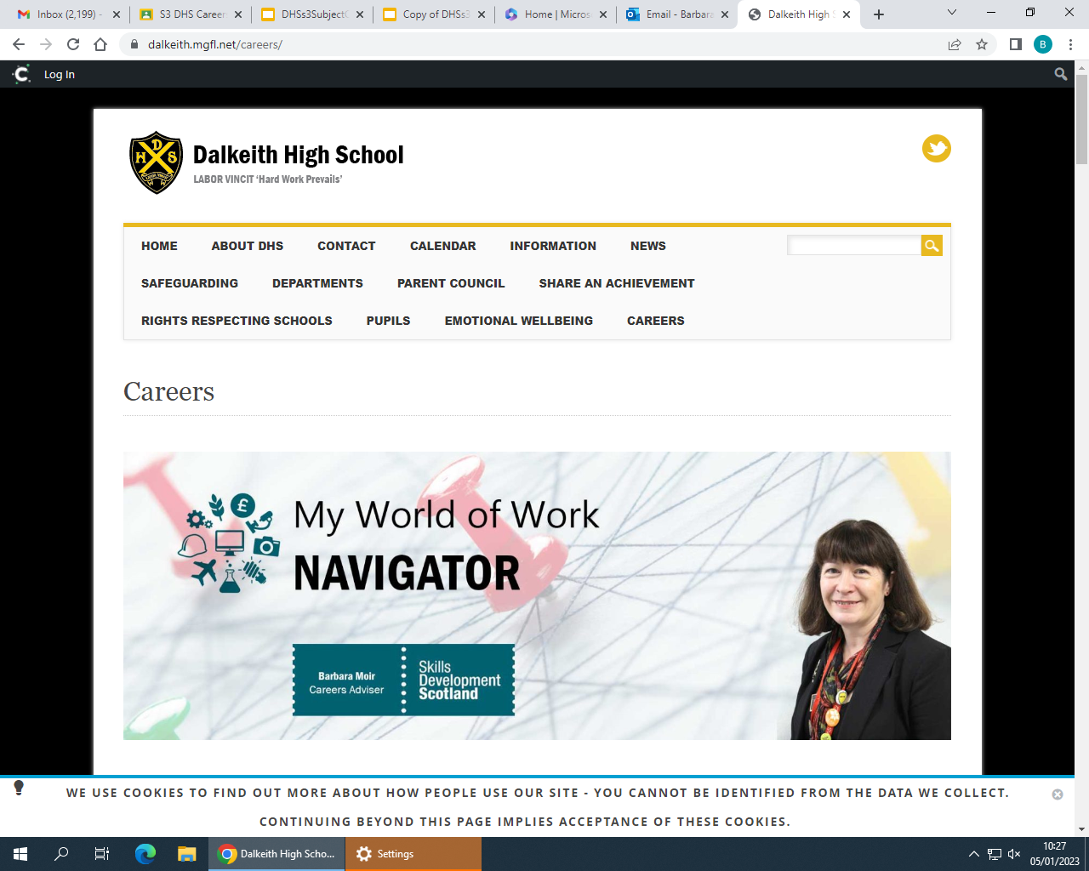

Slide 15
Notes:
Run through Action Plan - things to do before making their choices:
Register on My World of Work
Complete About Me quiz
Try the Strengths tool
Try the Skills tool
Use the Subject Choice tool
Bespoke landing page on MyWoW with content and links to all these actions...
myworldofwork.co.uk/subjectchoices

Slide 16
Barbara Moir Careers Adviser for Dalkeith High
barbara.moir@sds.co.uk
Careers Blog 3d7vmm6
S3 Careers Class jp36huk
Drop In – Every Tuesday Interval in the Dining Hall
Notes:
HAND OUT ‘FUTURE ME – SUBJECT CHOICES’ MAGAZINE
This slide is editable for local contact details/how to make appointment with adviser for 1:1 (remind them they can bring mum, dad, carer, teacher (or all of them) along to this discussion.
Let them know the school's local arrangements for setting these appointments with you up and highlight space on back page of magazine to note down these arrangements.

