Slide 1
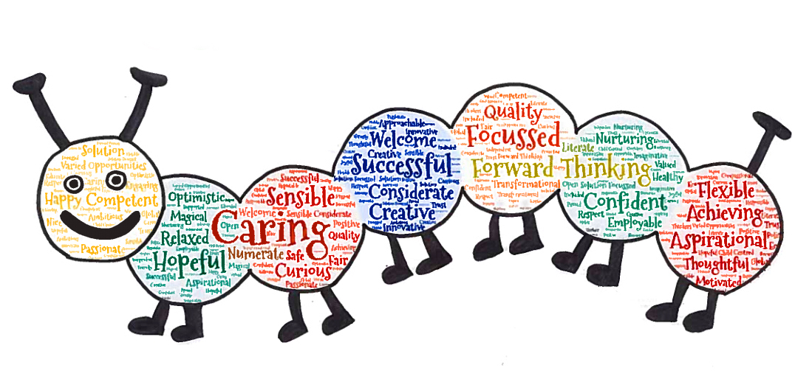
BONNYRIGG HOME LEARNING GRID.
Dough creations: Make something out of salt dough. This could be something to hang on a tree, a tile or even a creature. Date the back to remember your time at home learning. | STEM: Can you complete the challenge – how tall can you build a tower with only two bits of paper? | Indoor Activities: Try a few of the 100 indoor activities.
Learning Time: Check your Class Team for a numeracy or literacy activity. | Quiz night: Create a quiz of 4/5 categories and host your own quiz for your family and/or friends. | Art: Find 10 facts about Andy Warhol. Create your own masterpiece inspired by Andy Warhol.
Lego Challenge: Some teachers from Bonnyrigg have set a few Lego challenges. Try some out. | Active Time: Have a go at some of the Virtual Sports Day activities. https://www.thinglink.com/card/1324816909186629634 | Learning Time: Check your Class Team for a numeracy or literacy activity.
Yearbook: As it nears end of term think back over the year about what you have enjoyed. Fill out the yearbook as a reminder or create your own. | Virtual Class Trip: Try out up to 17 virtual tours. Write a short review or draw a picture of each one you visit. https://www.thinglink.com/card/1324661602867216386 | Reflecting on Learning: What have you learned today? Share with your Class Team.

