Slide 1
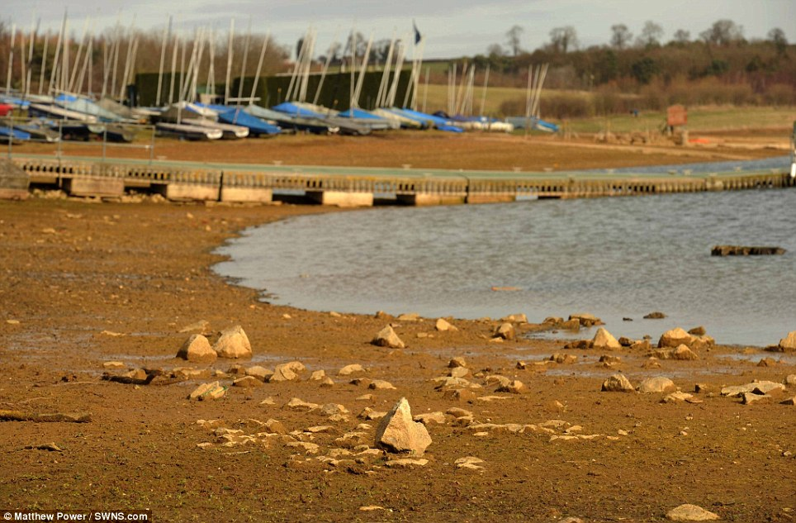
DRY DROUGHT

Slide 2
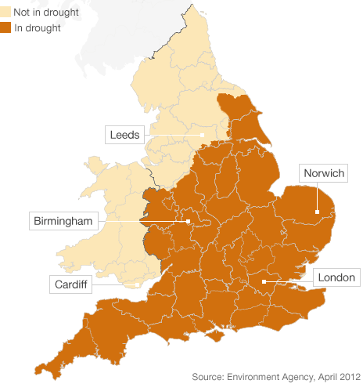
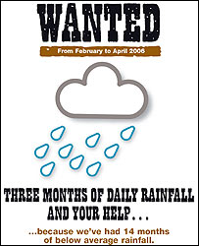
Hose pipe bans were put in place.

Slide 3
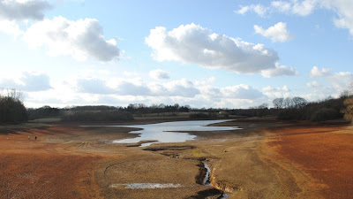
Lakes dried up, local businesses lost money.

Slide 4
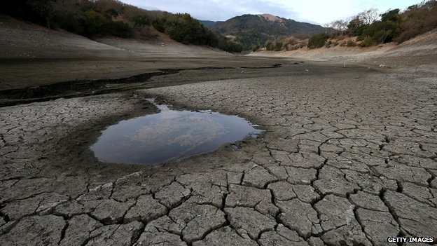
Reservoirs run dry, no running water.

Slide 5
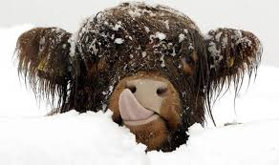
SUPER SNOW

Slide 6
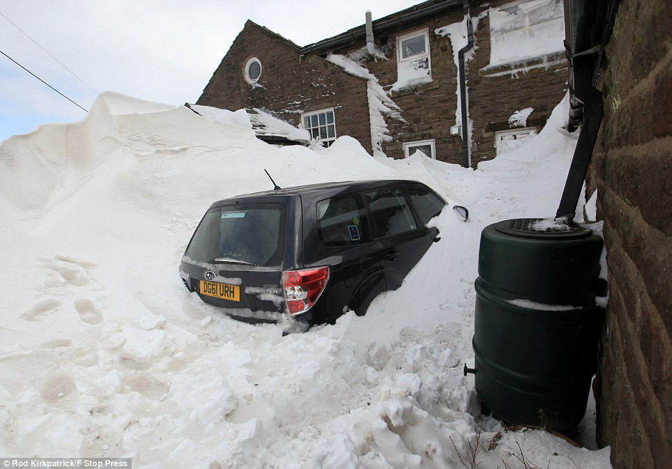
Trapped inside your home for days.

Slide 7
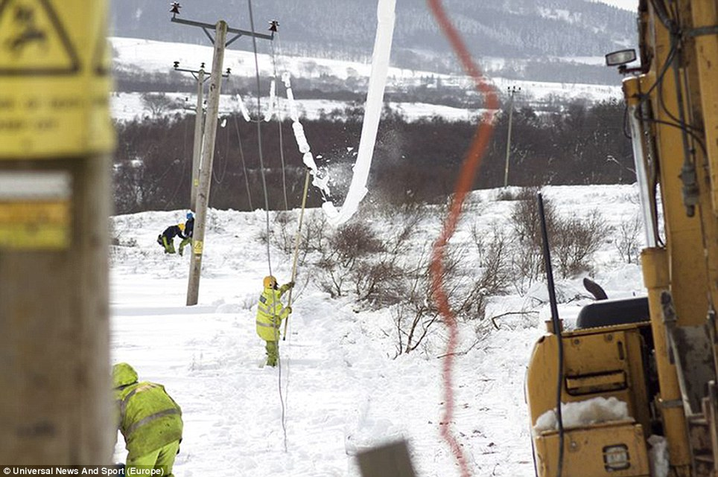
Electricity pylons were damaged, in remote areas.

Slide 8
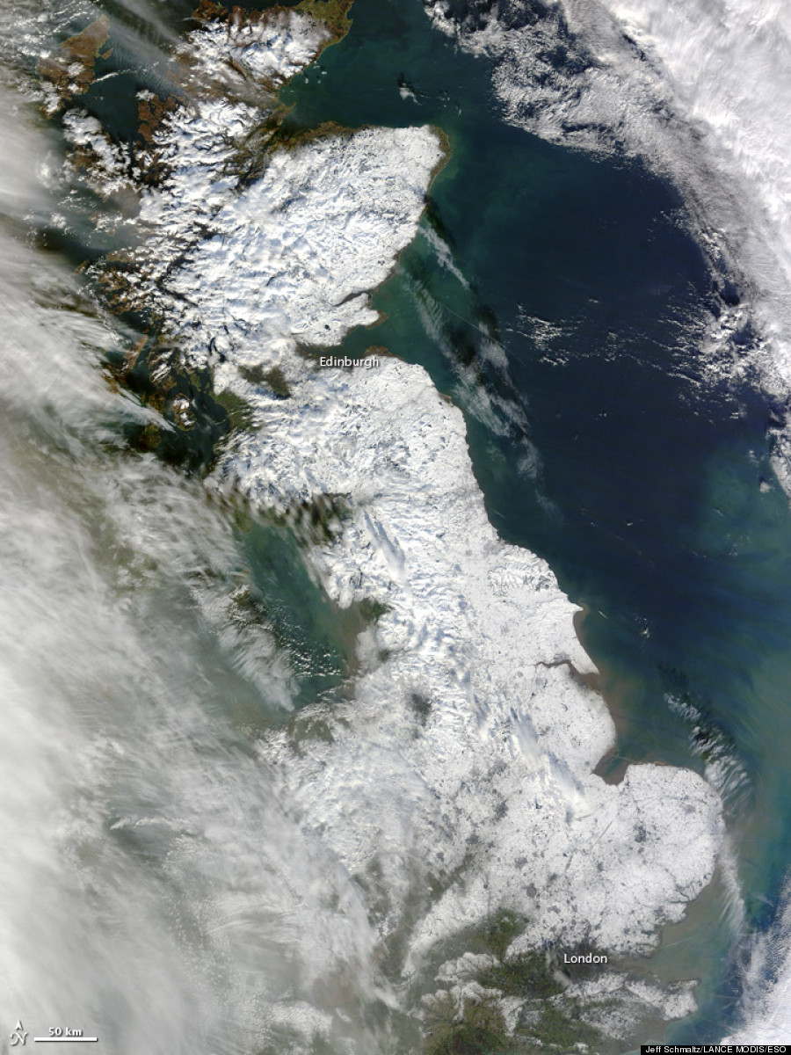
A glimpse of how much snow fell.

Slide 9
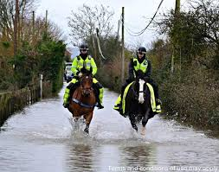
FREEZING FLOODS

Slide 10
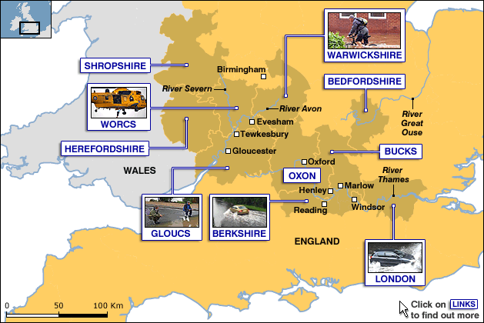
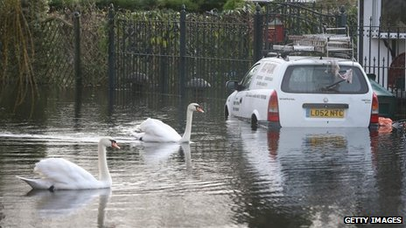
10 counties put on high floods risk.

Slide 11
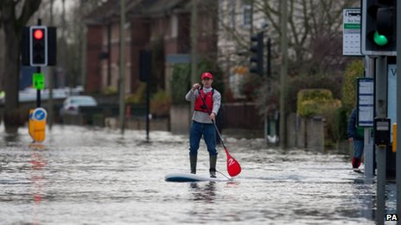
Travel was made near impossible by vehicle.

Slide 12
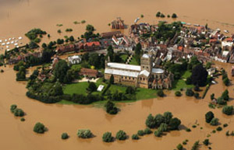
Whole towns were cut off and surrounded.

Slide 13
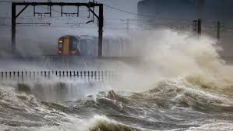
TERRIBLE TIDES

Slide 14
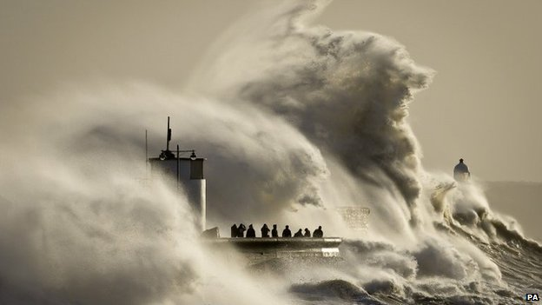
Huge tidal surges crashed into the shore.

Slide 15
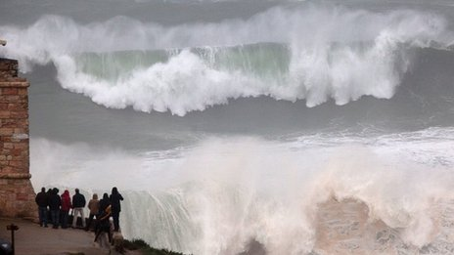
Waves up to 30 feet crashed into the shore.

Slide 16
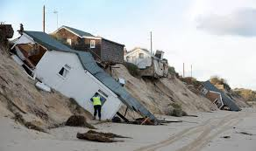
COSTLY COASTS

Slide 17
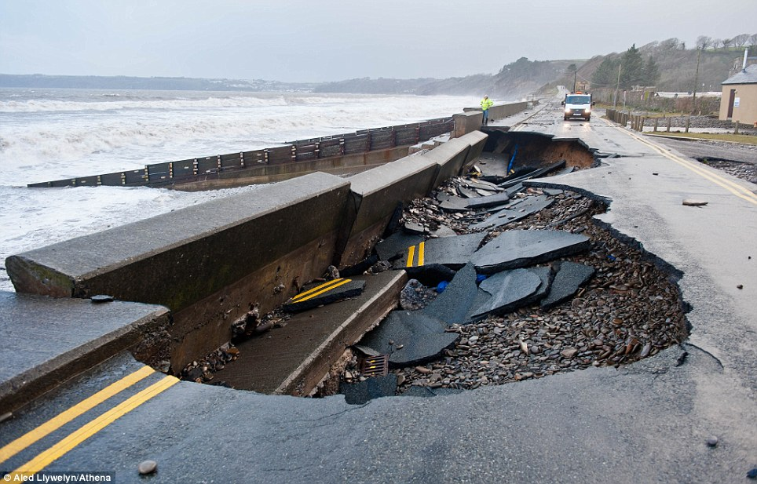
Even with seawalls as a defence coastal damage was immense.

Slide 18
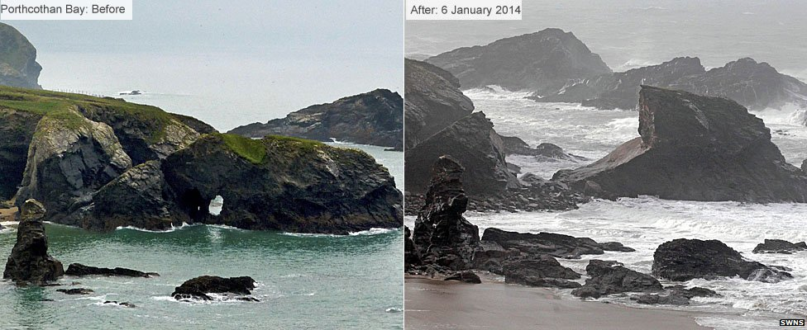
Before and after the coastal erosion by the wind and waves.

Slide 19
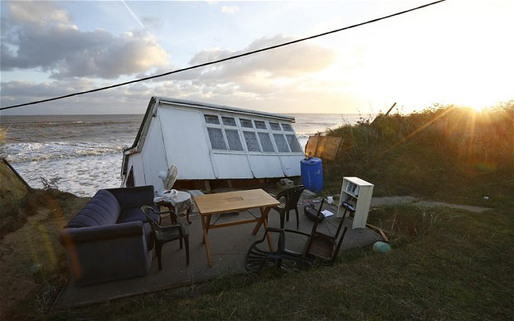
The foundations of buildings were destroyed allowing them to fall into the sea.

Slide 20
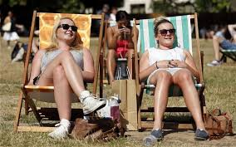
SCORCHING SUMMER

Slide 21
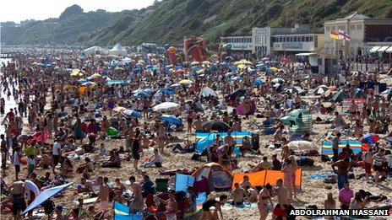
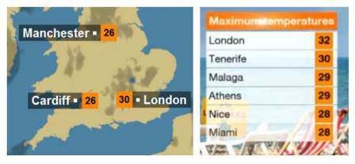
No point in going on holiday.

Slide 22
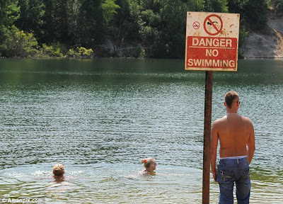
People could not resist the dangers of a cooling dip.

Slide 23
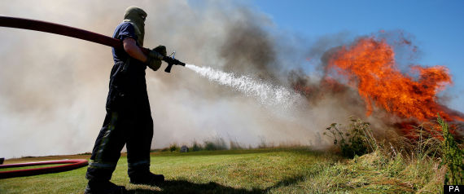
Bush fires broke out all of the country.

